Slide 1
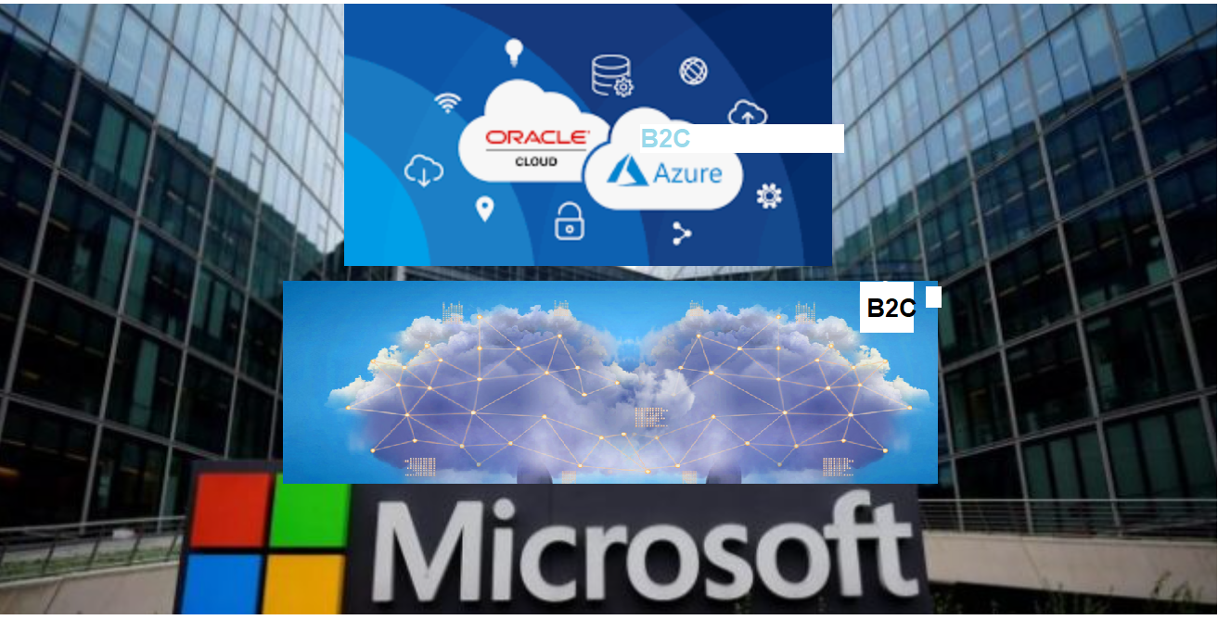
Jit
PM
Azure AD B2C With Oracle

Slide 2
Agenda
Azure B2C with Oracle
Using SAML
Oracle Identity provider setup
MS Azure B2C App setup
Configuration of App
Testing of the flow
Using Open ID/oAuth 2.0
Oracle Identity provider setup
Create and Configure IDCS App.
MS Azure B2C App setup
Configuration of Open ID connect
Testing of the flow.
Using IEF Custom Policies
Oracle Identity provider setup
Create and configure Oracle environment for Azure B2C.
MS Azure B2C App setup
Configuration of Custom policies and upload.
Testing of the flow.

Slide 3
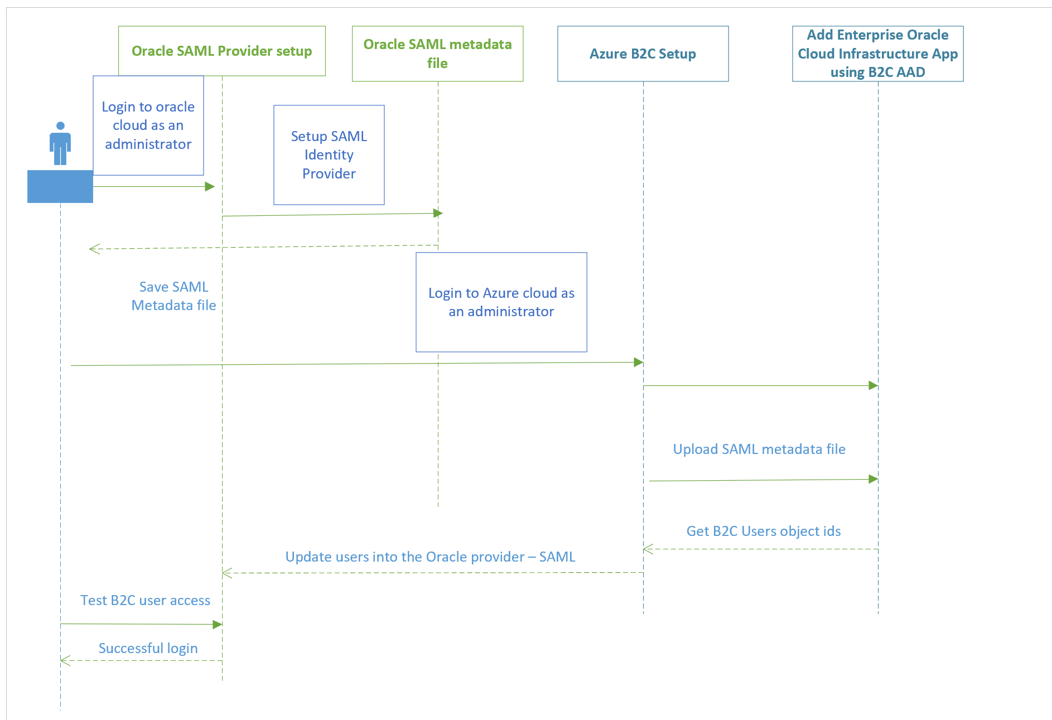
Oracle Setup for Cloud - SAML
Login to https://cloud.oracle.com
Create Identity provider using Federation menu
Instructions for Federating with Oracle Identity Cloud Service

Slide 4
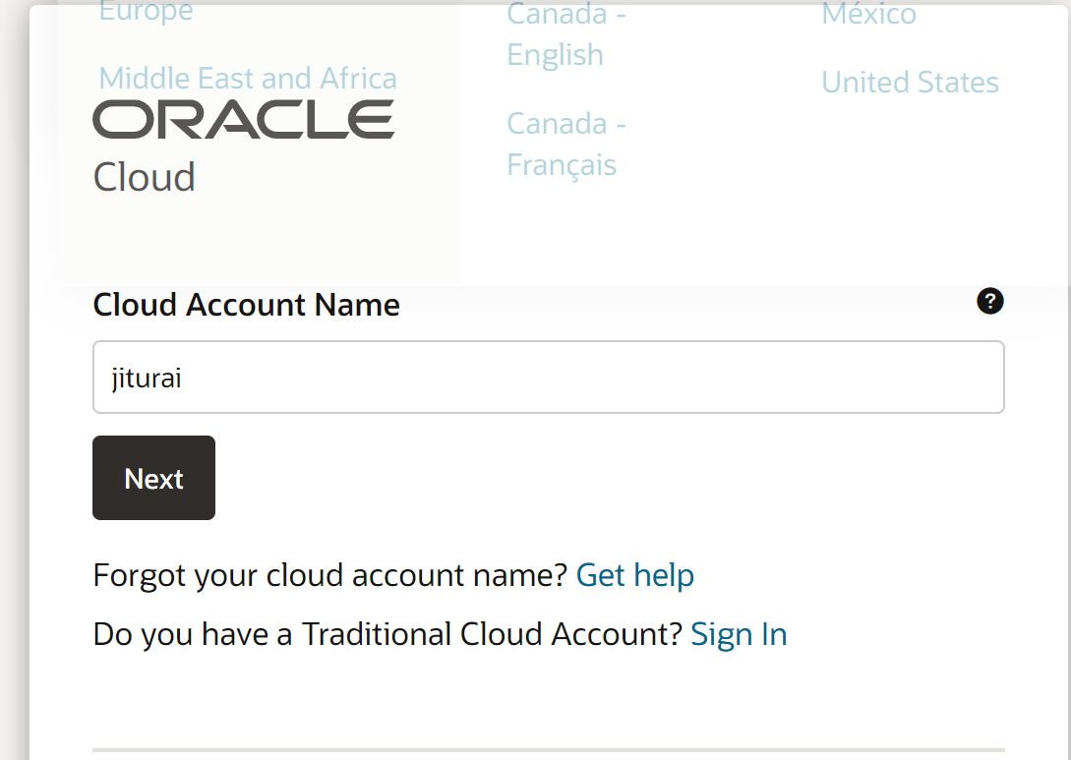
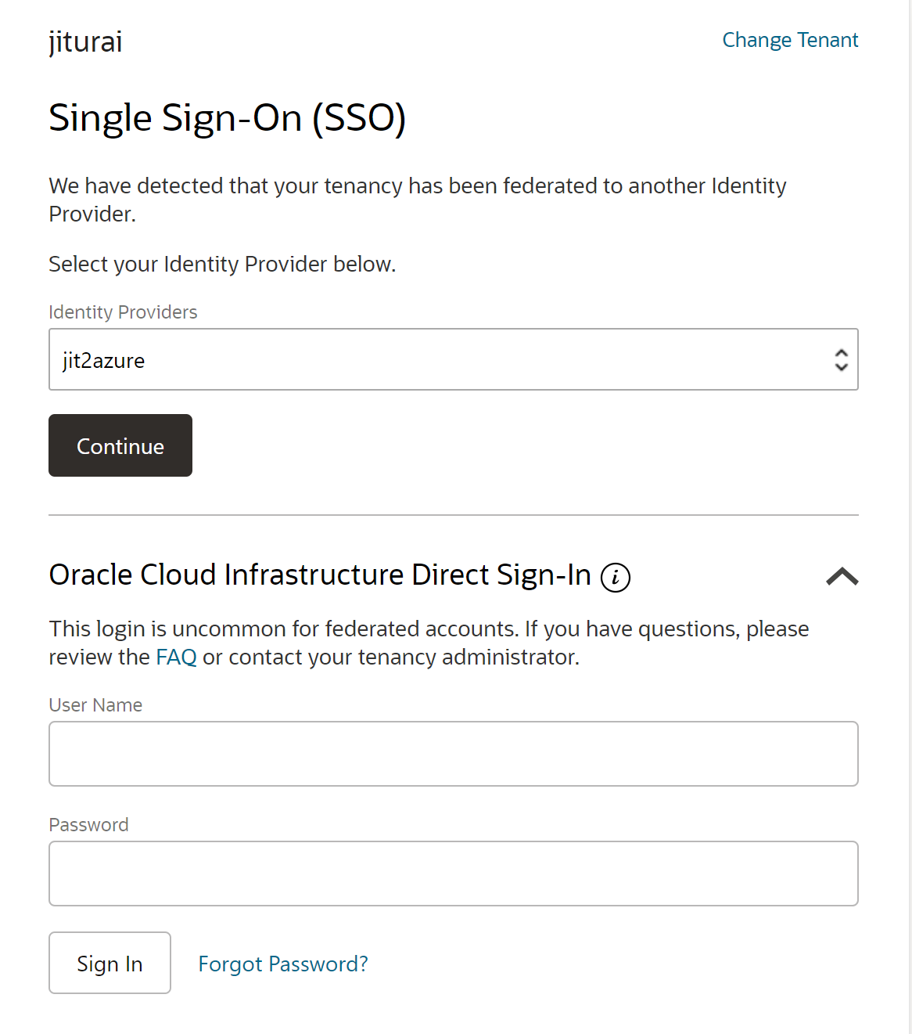
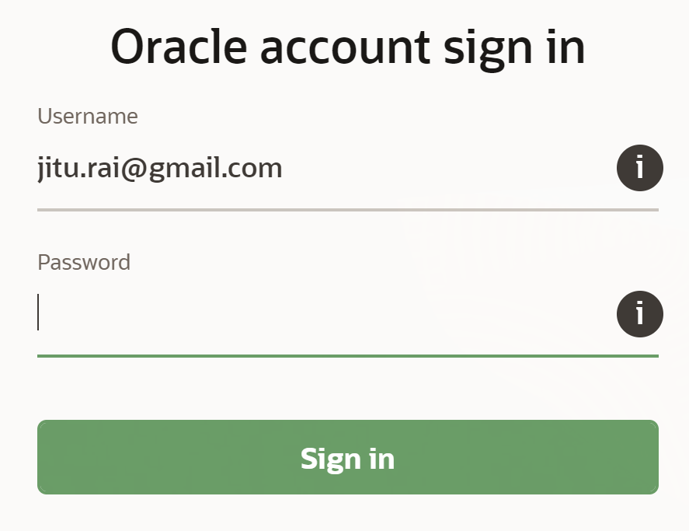
Oracle Setup for Cloud
Login to https://cloud.oracle.com
Create Identity provider using Federation menu
Instructions for Federating with Oracle Identity Cloud Service
User name:- Jitu.rai@xxx.com
Password:- xxxxx

Slide 5
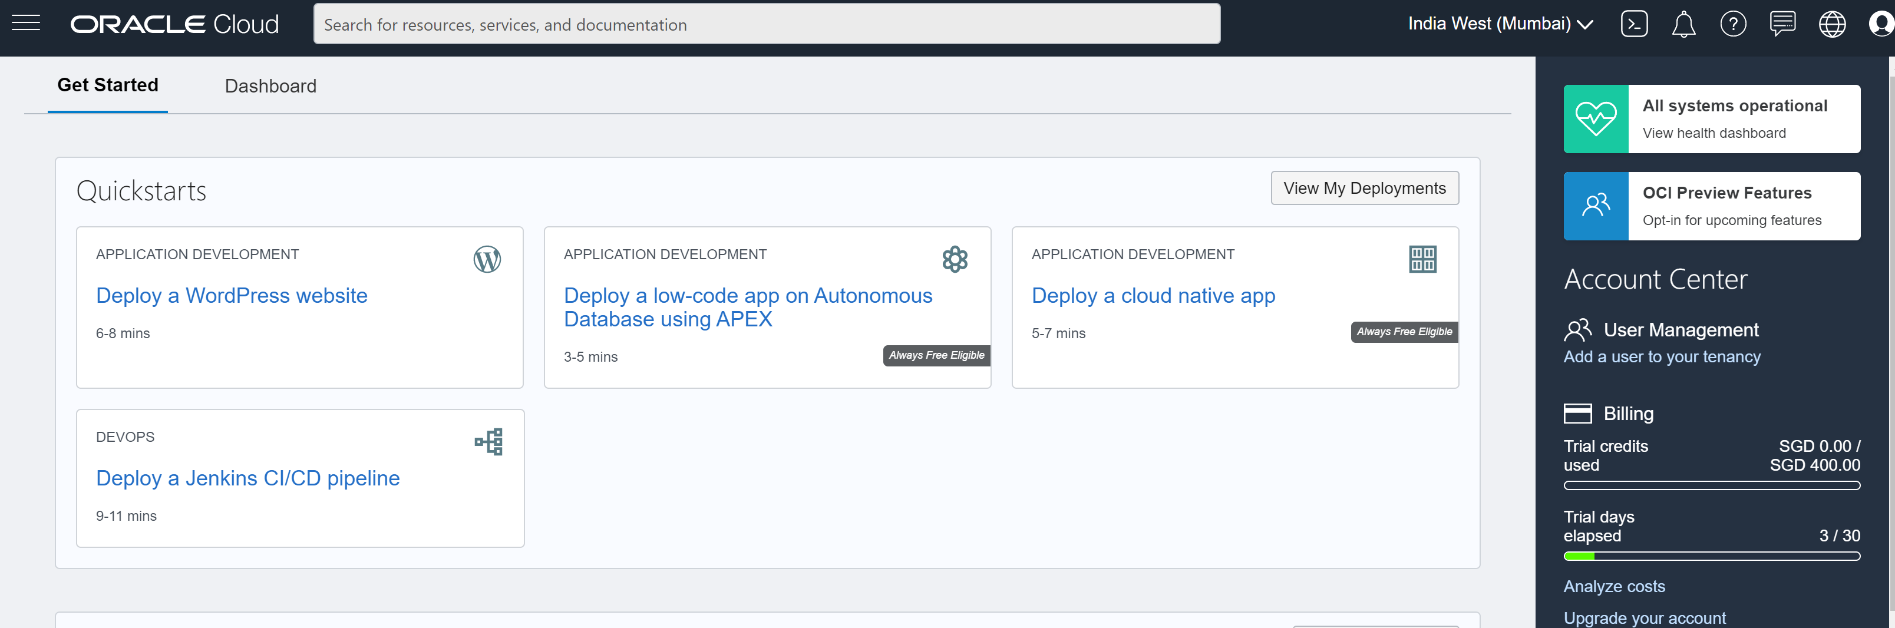
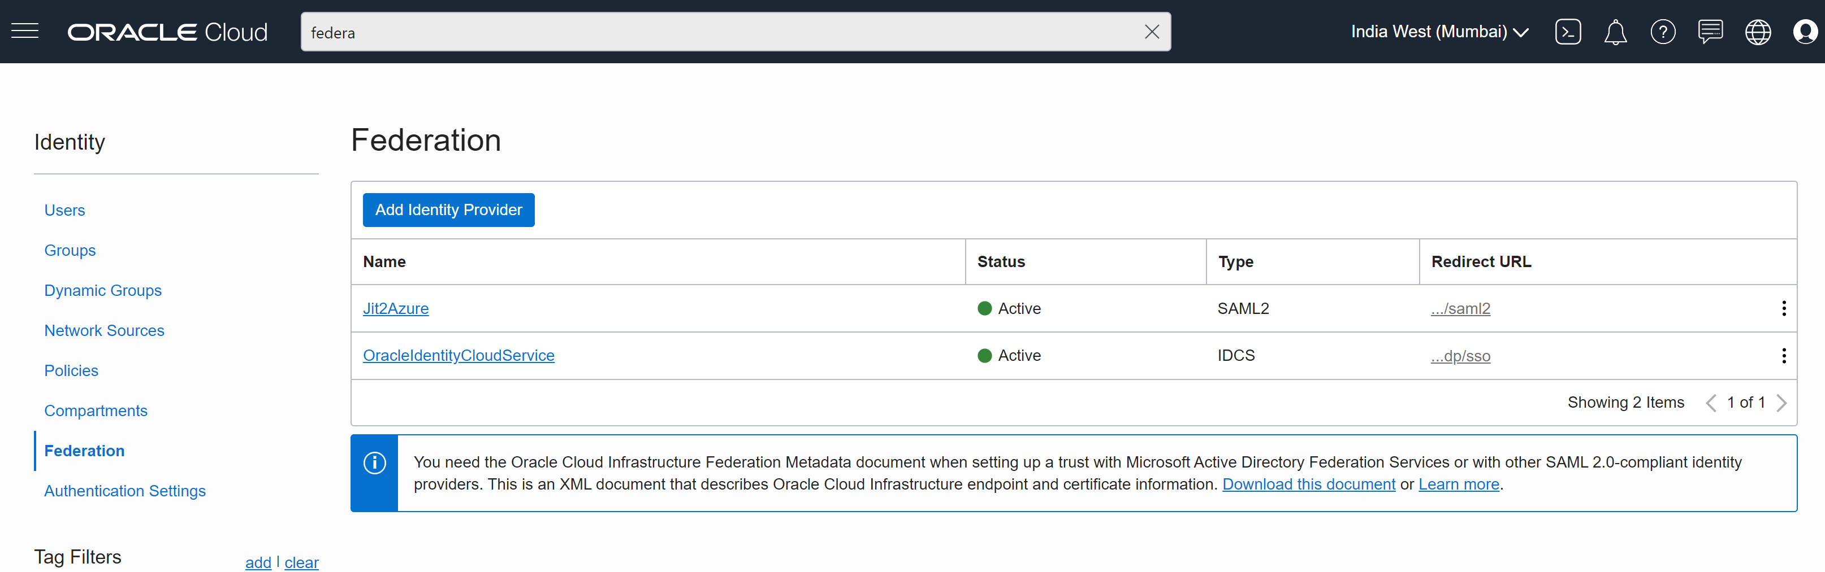
Oracle Setup
Azure B2C with Oracle
Azure B2C with Oracle
Download the SAML Metadata file for Azure B2C SAML signon

Slide 6
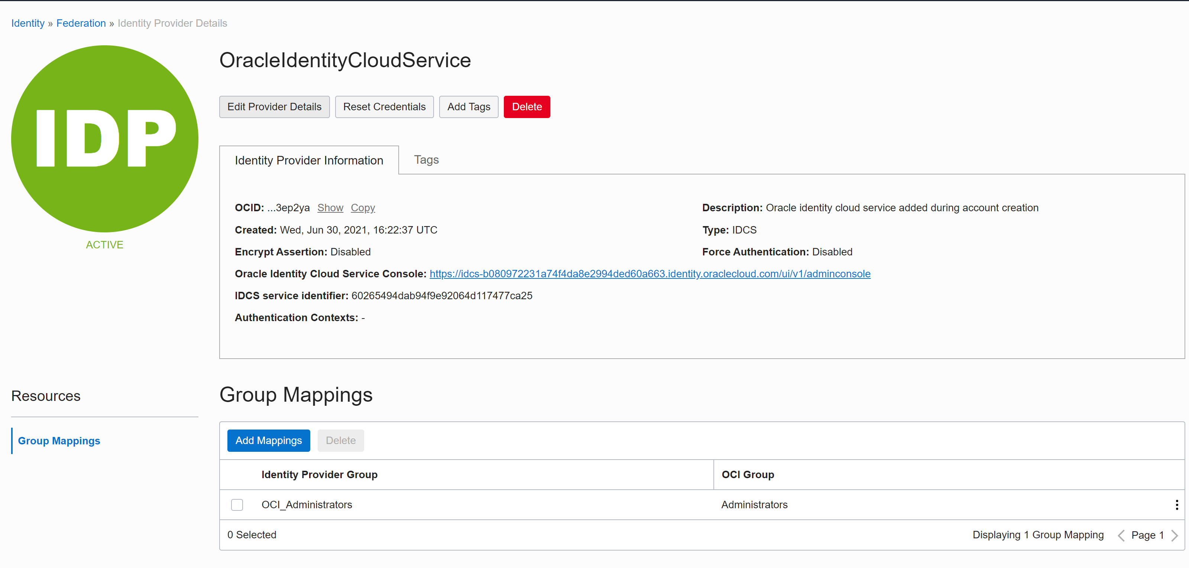
Oracle Setup
Azure B2C with Oracle

Slide 7
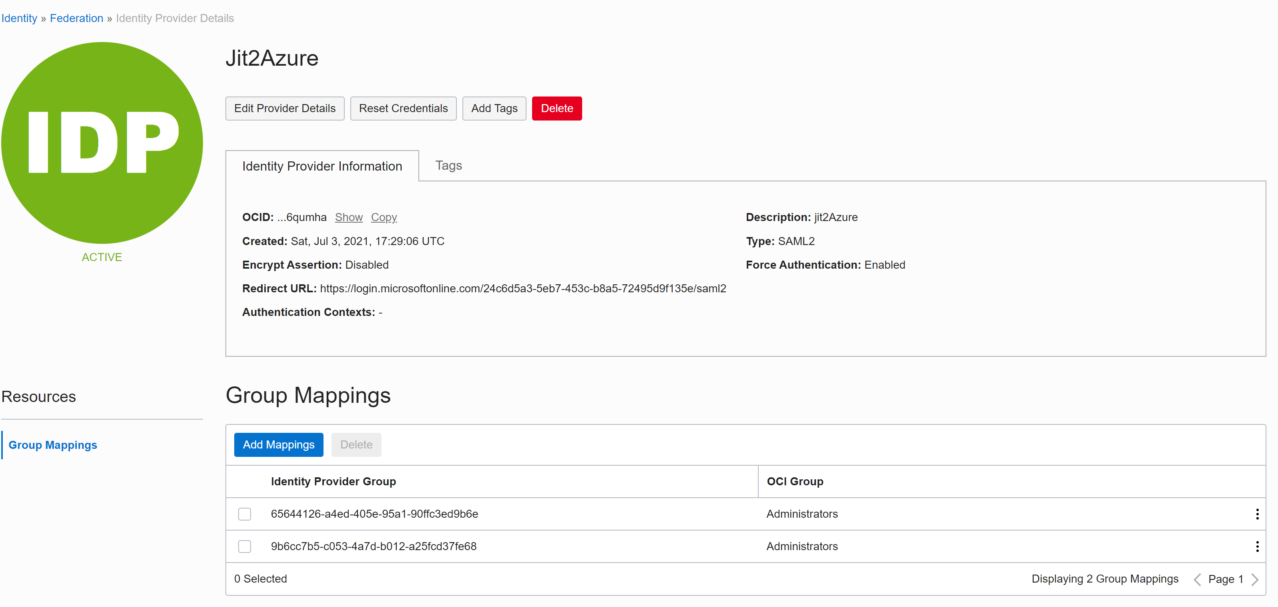
Oracle Setup
Azure B2C with Oracle

Slide 8
Oracle Setup
Azure B2C with Oracle

Slide 9
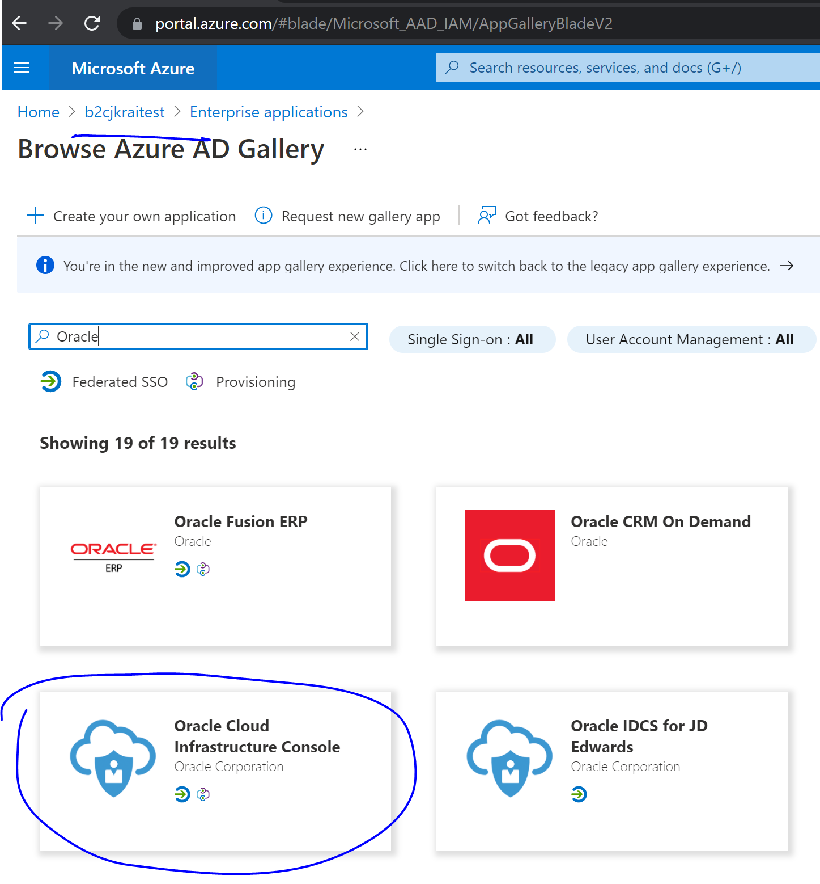
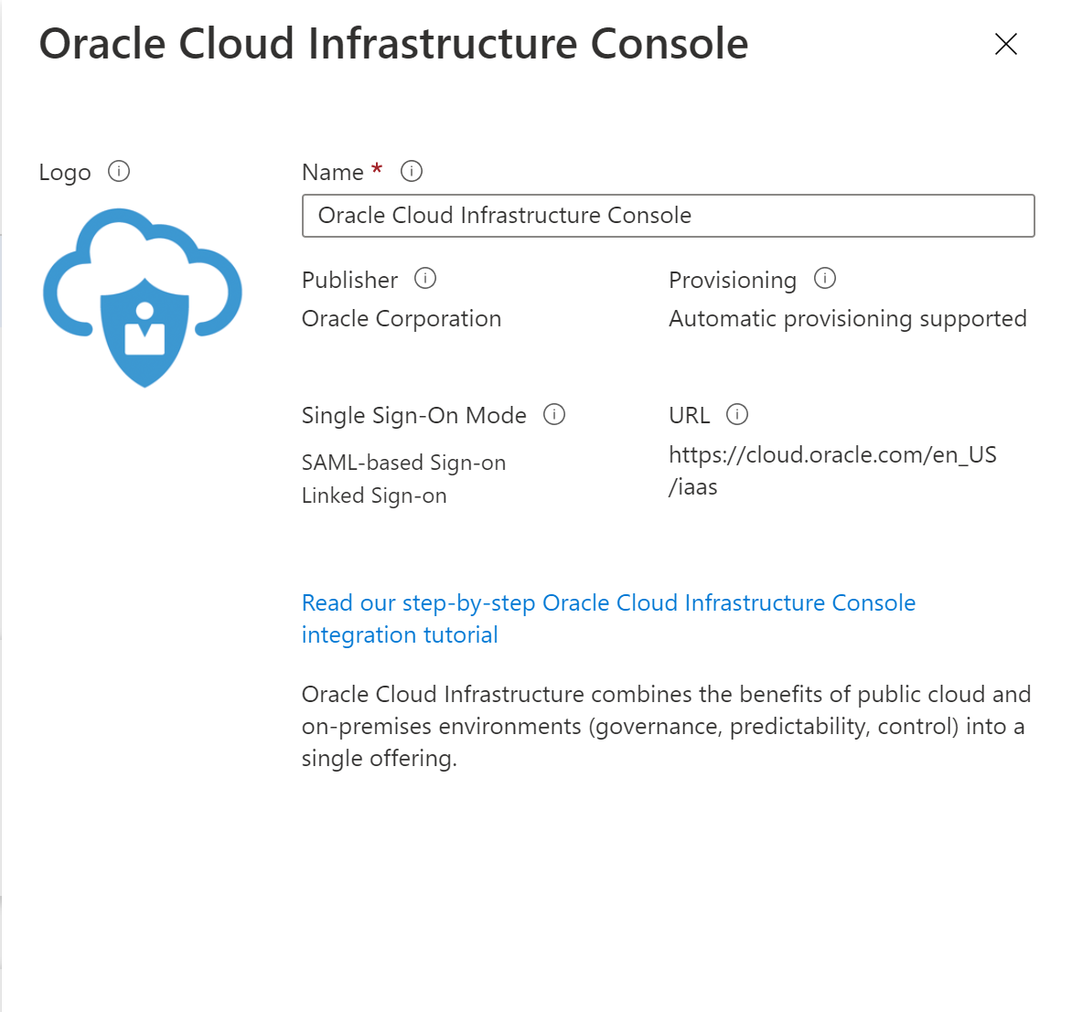
Azure B2C Setup - Azure
Azure B2C with Oracle
1. Login to portal.azure.com
2. Switch to the B2C tenant
3. Open AAD for the B2C tenant
4. Add Oracle Cloud Infrastructure Console using
Enterprise Application.
5. Provide the information as required.

Slide 10
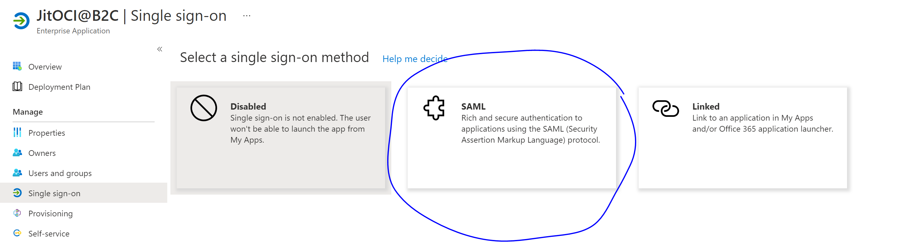
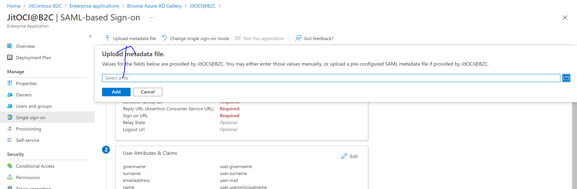
Azure B2C Setup - Azure
Azure B2C with Oracle
Upload metadata file downloaded from Oracle SAML file.

Slide 11
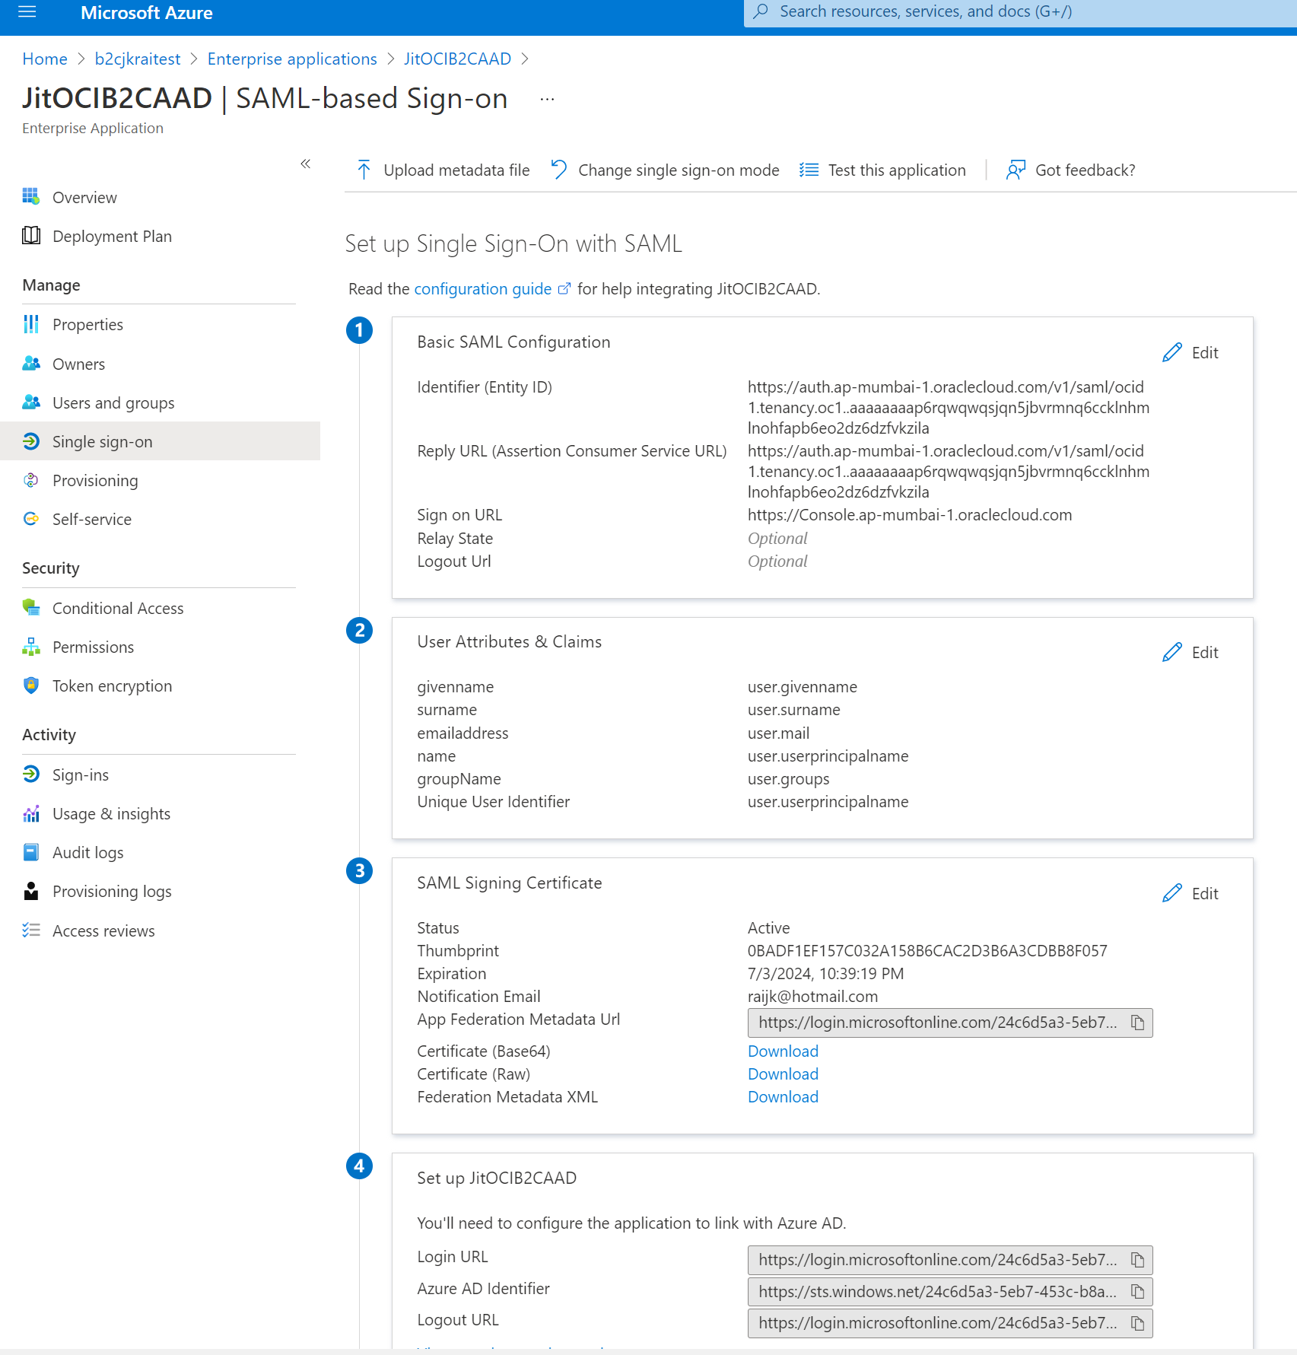
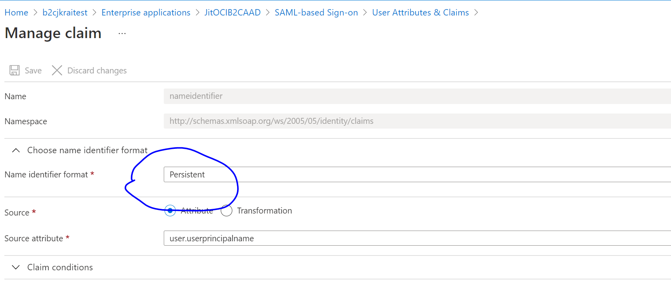
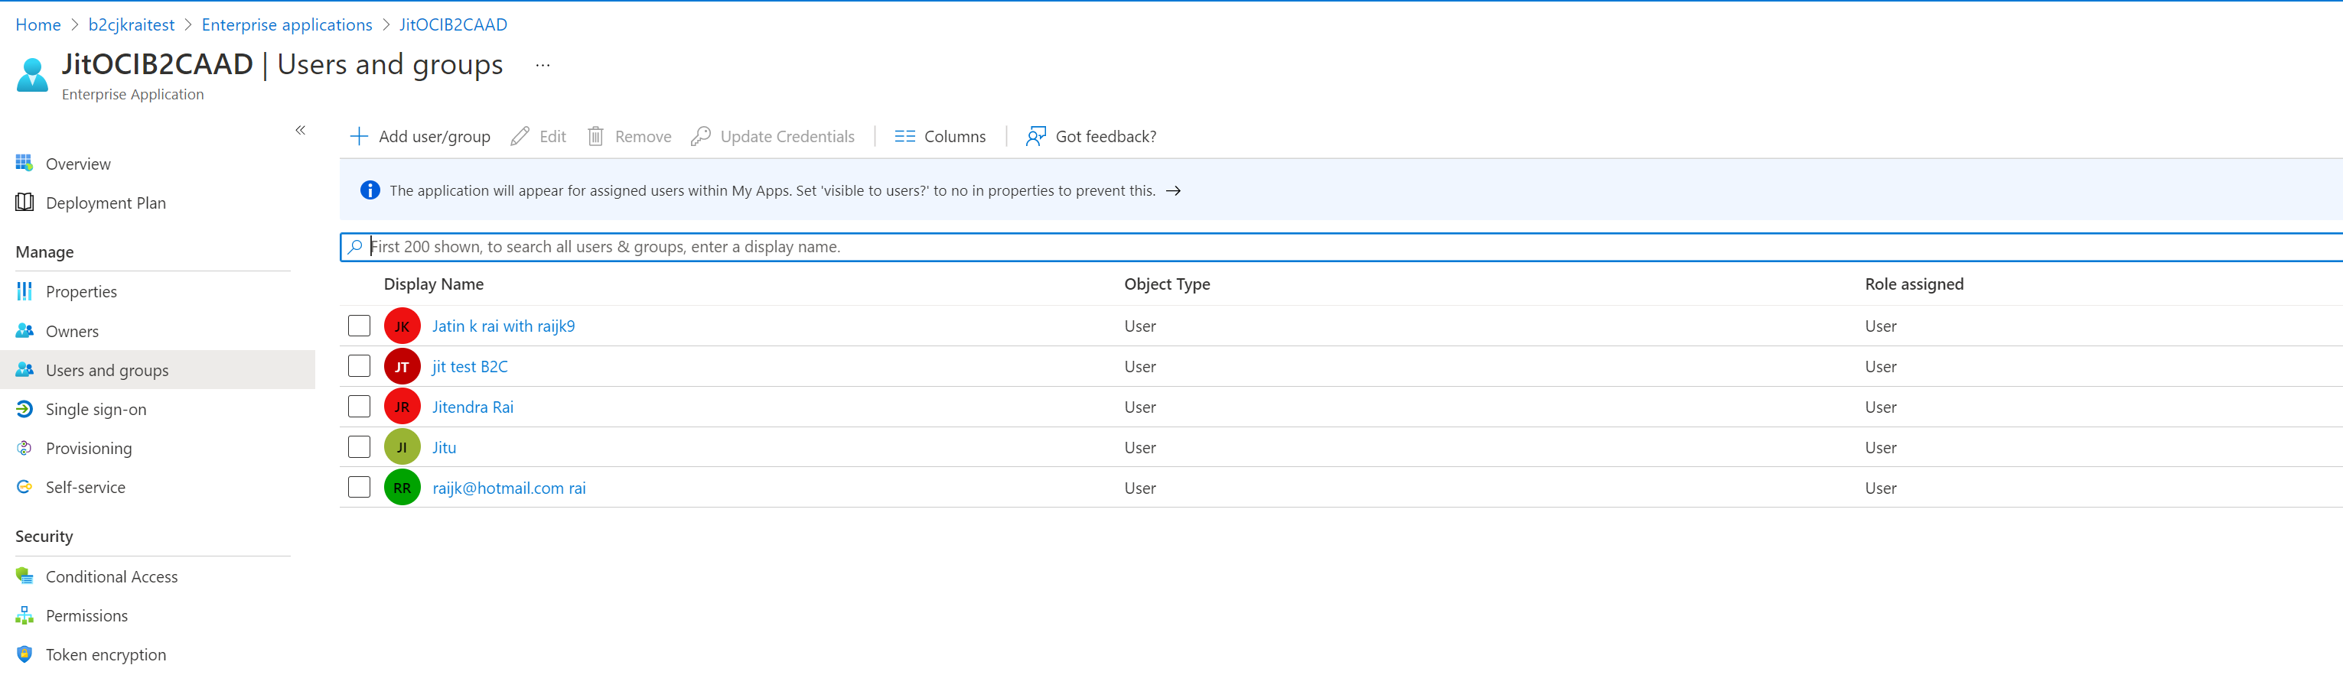
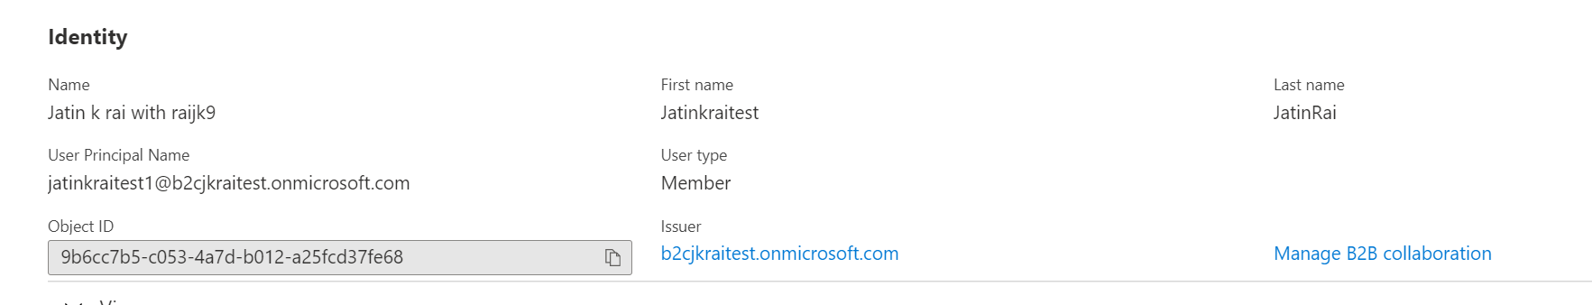
Azure B2C Setup - Azure
Azure B2C with Oracle
Note the object ids of each user and map into the Oracle SAML Group mapping of slide#7.

Slide 12
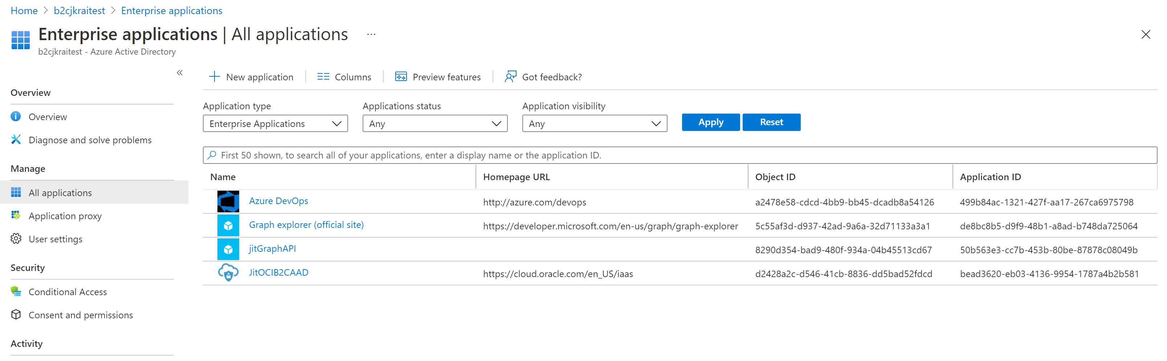
Azure B2C Setup
Azure B2C with Oracle

Slide 13
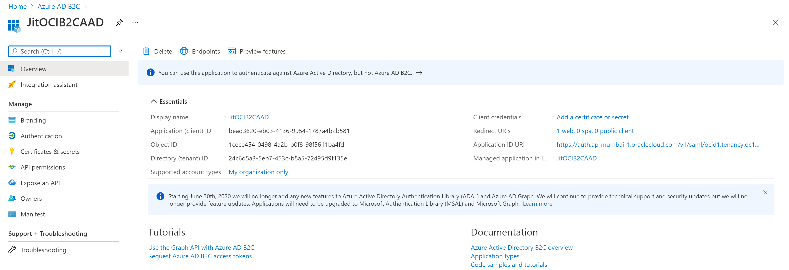
Azure B2C Setup
Azure B2C with Oracle
1. Login to portal.azure.com
2. Switch to the B2C tenant
3. Open AAD for the B2C tenant
4. Add Oracle

Slide 14
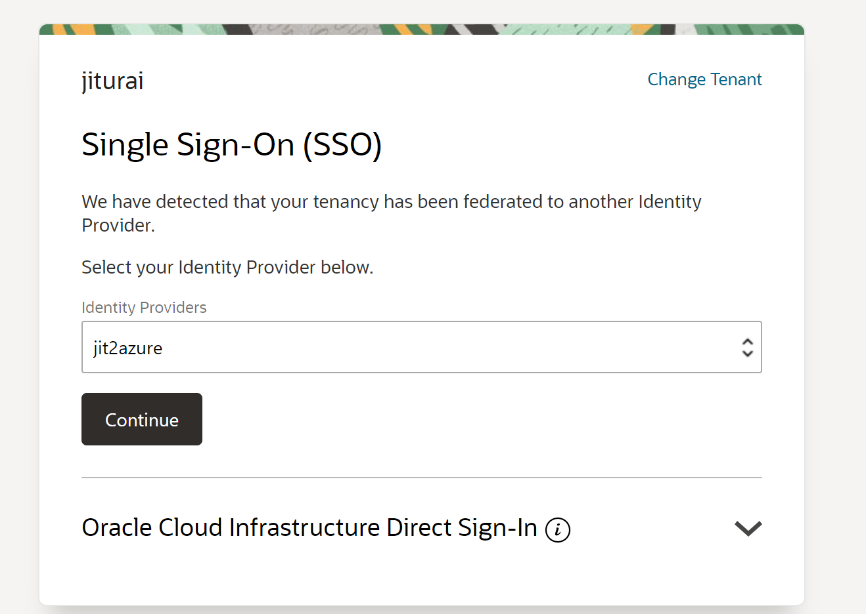
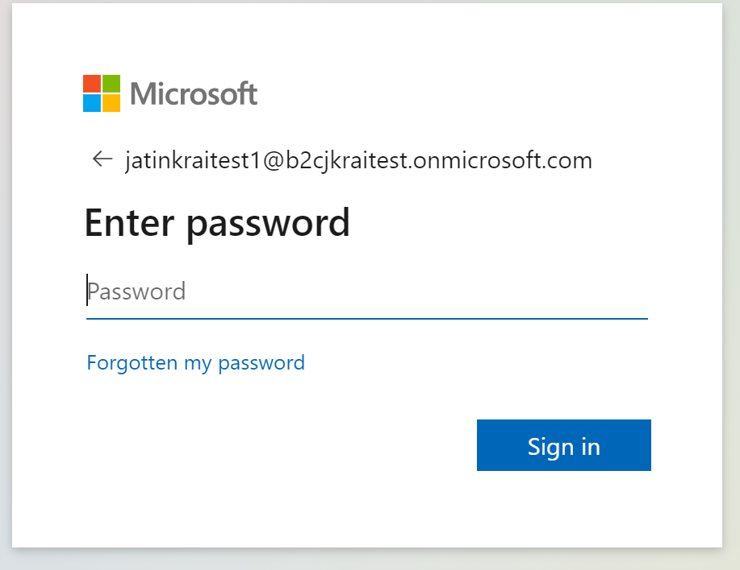
Azure B2C - Testing
Azure B2C with Oracle
Login to the https://cloud.oracle.com
Click on the account
Oracle to MS site

Slide 15
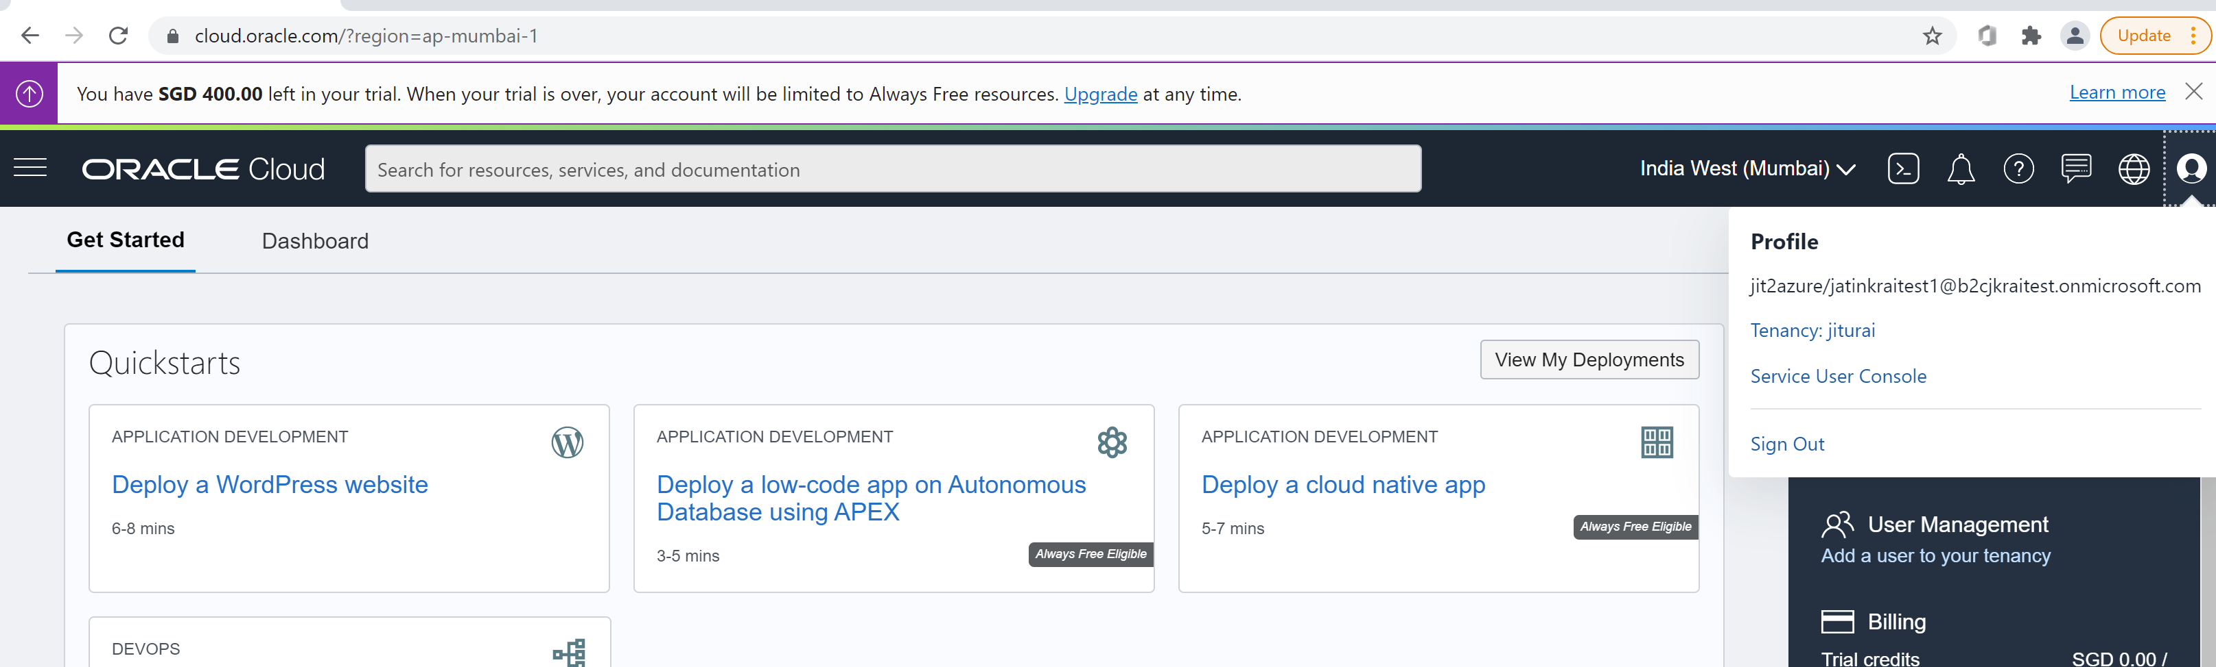
Azure B2C - Testing
Azure B2C with Oracle
After successful login with Microsoft B2C users
You can see the successful OCI screen.
MS B2C tenant User

Slide 16
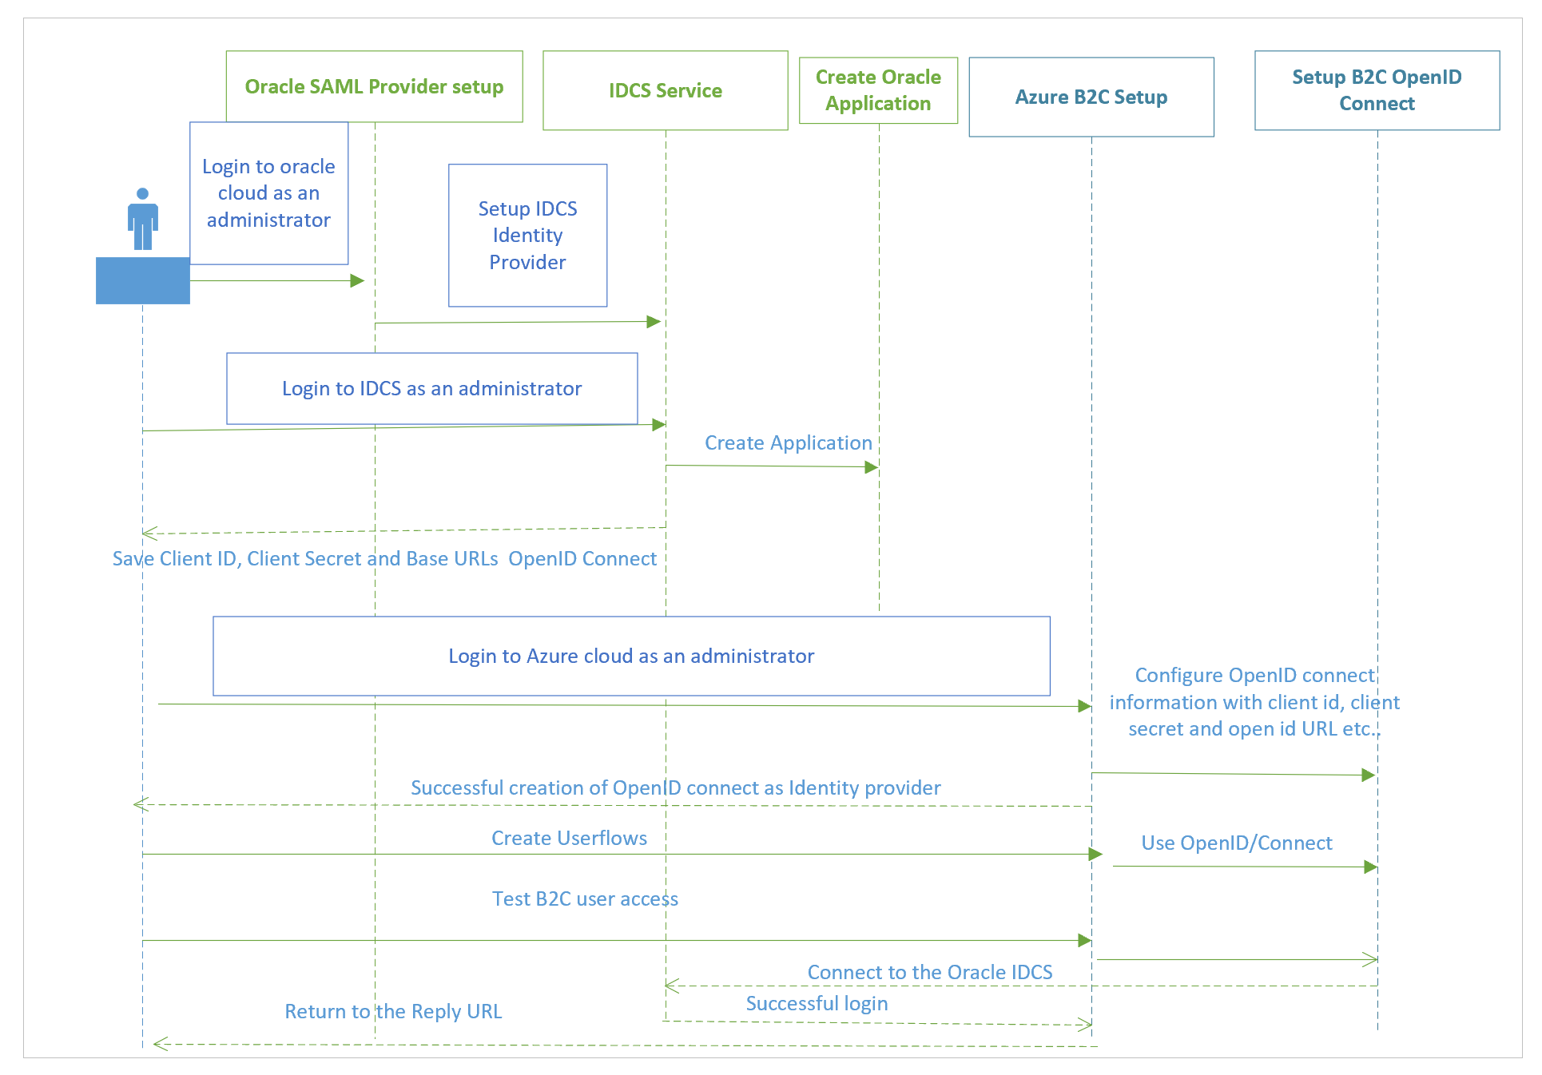
Oracle Setup for Cloud – OpenID/IDCS
Login to https://cloud.oracle.com
Create Identity provider using Federation menu
Instructions for Federating with Oracle Identity Cloud Service

Slide 17
Oracle Setup for Cloud
Login to https://cloud.oracle.com
Create Identity provider using Federation menu
Instructions for Federating with Oracle Identity Cloud Service
User name:- Jitu.rai@xxx.com
Password:- xxxxx

Slide 18
Oracle Setup
Azure B2C with Oracle
Azure B2C with Oracle

Slide 19
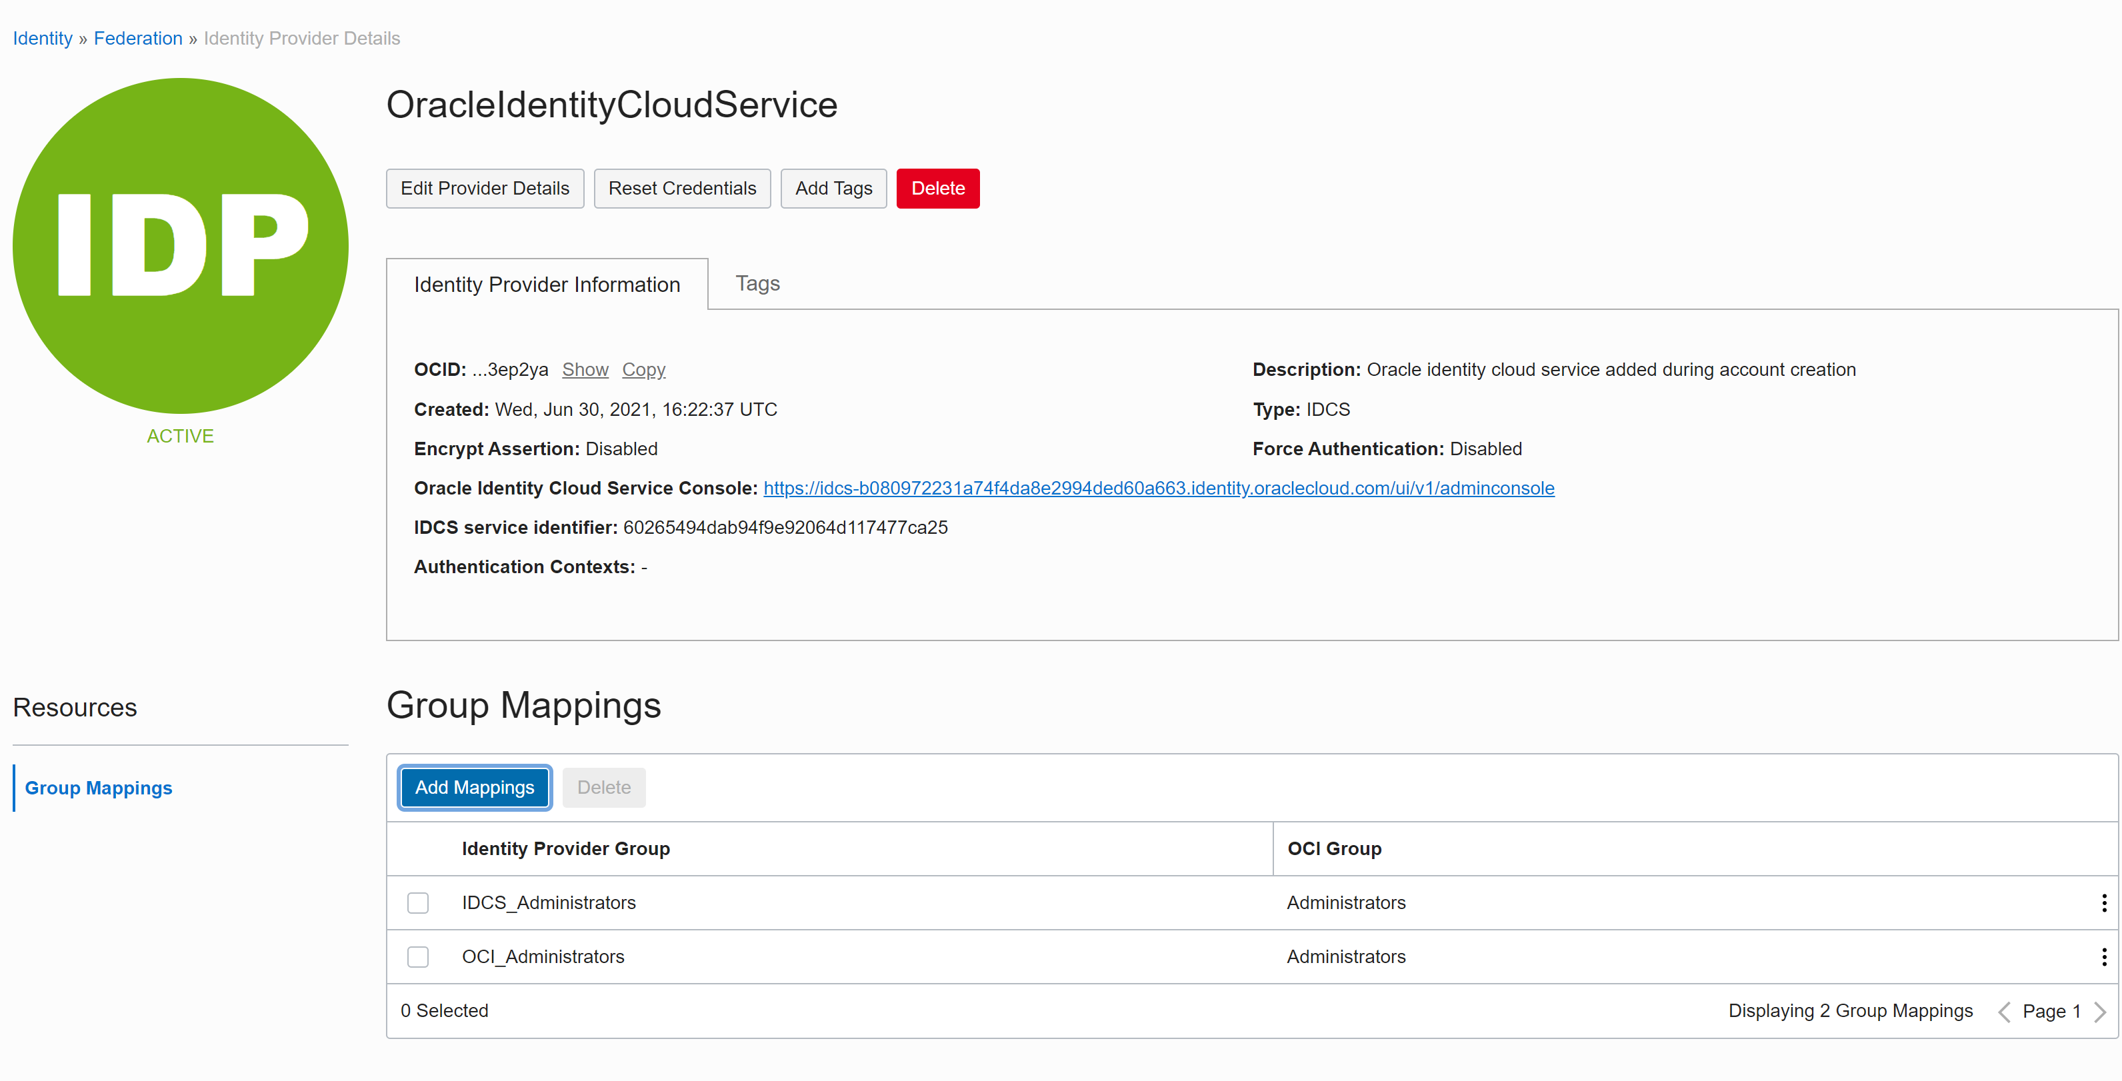
Oracle Setup
Azure B2C with Oracle
Base URL of IDCS

Slide 20
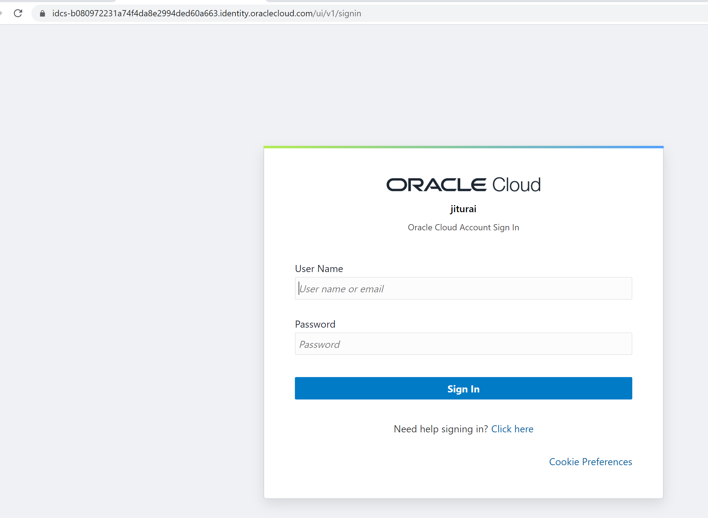
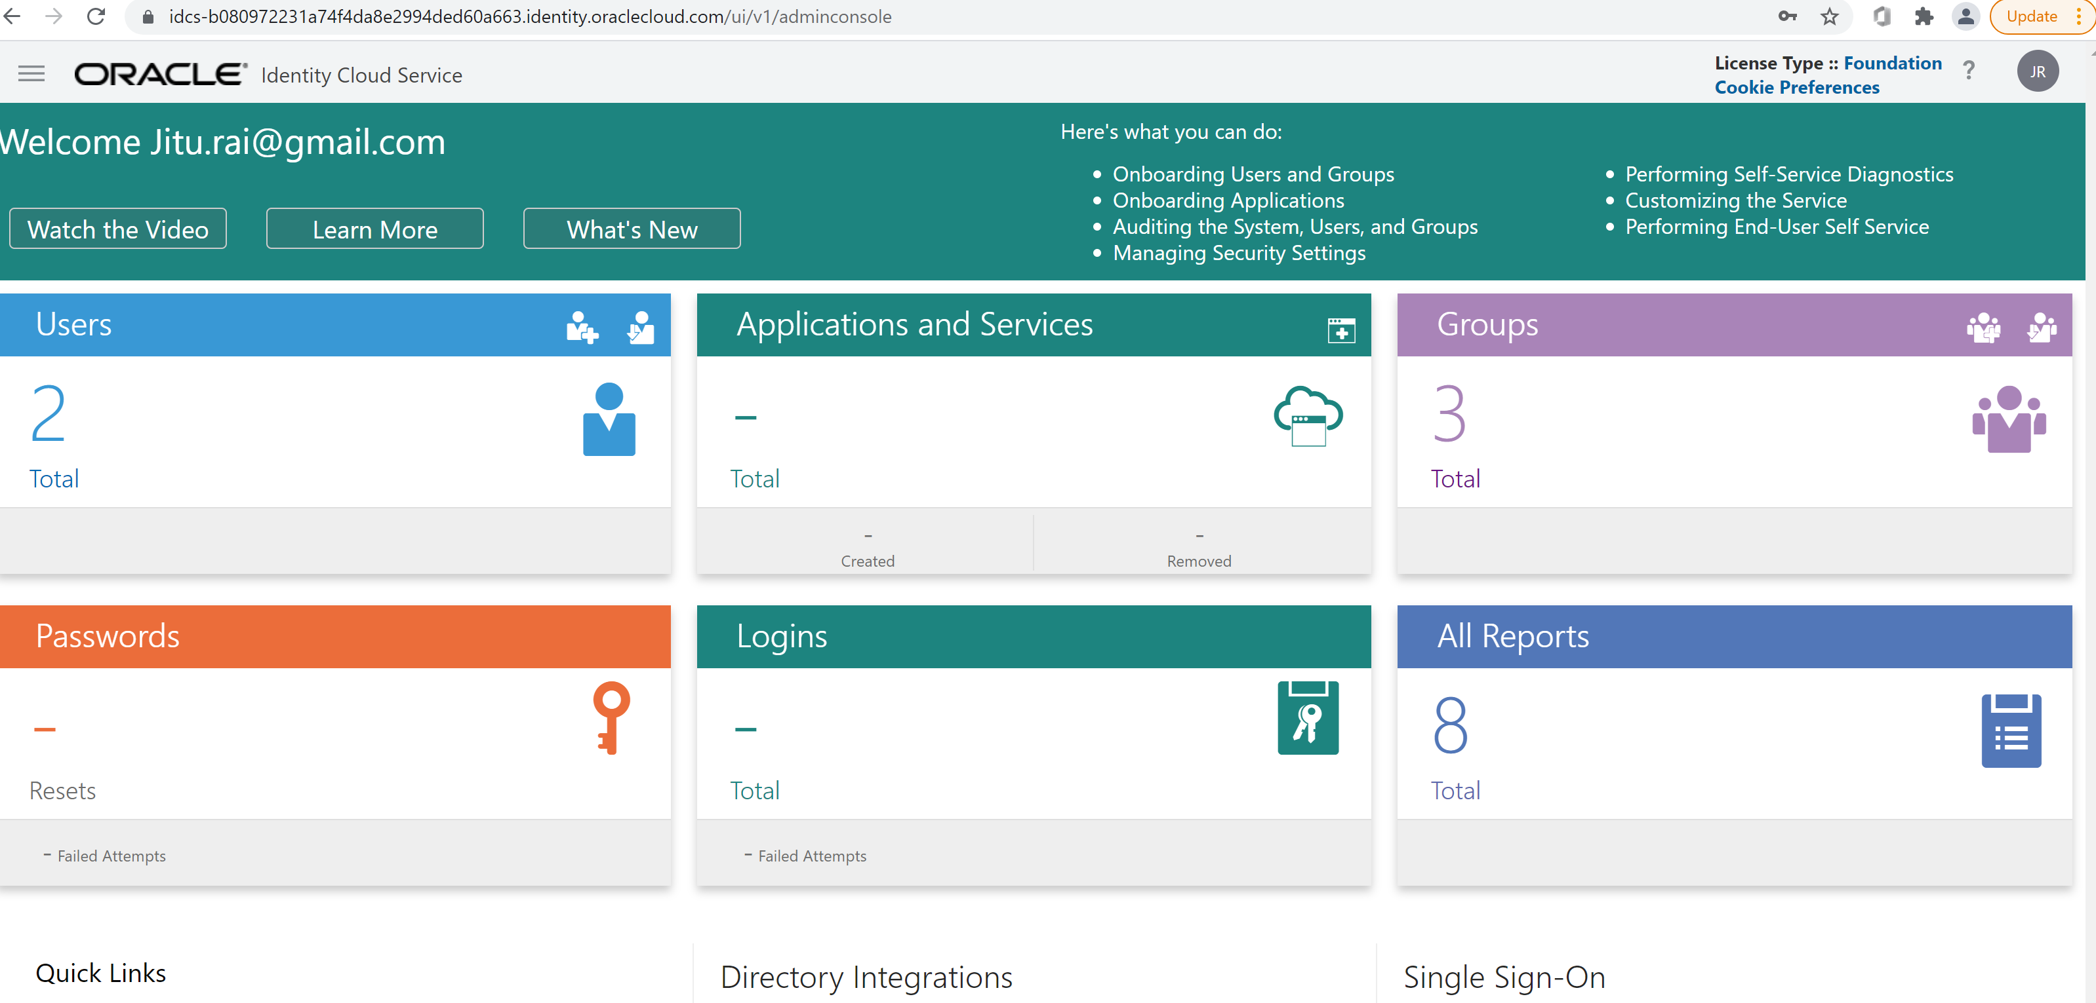
Oracle Setup
Azure B2C with Oracle
Login to the IDCS - https://idcs-b080972231a74f4da8e2994ded60a663.identity.oraclecloud.com/ui/v1/adminconsole
Successful login

Slide 21
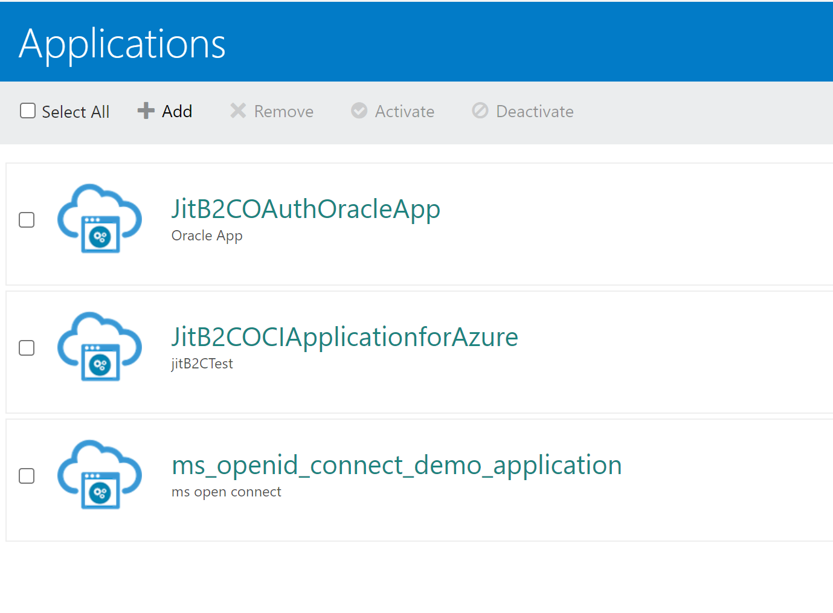
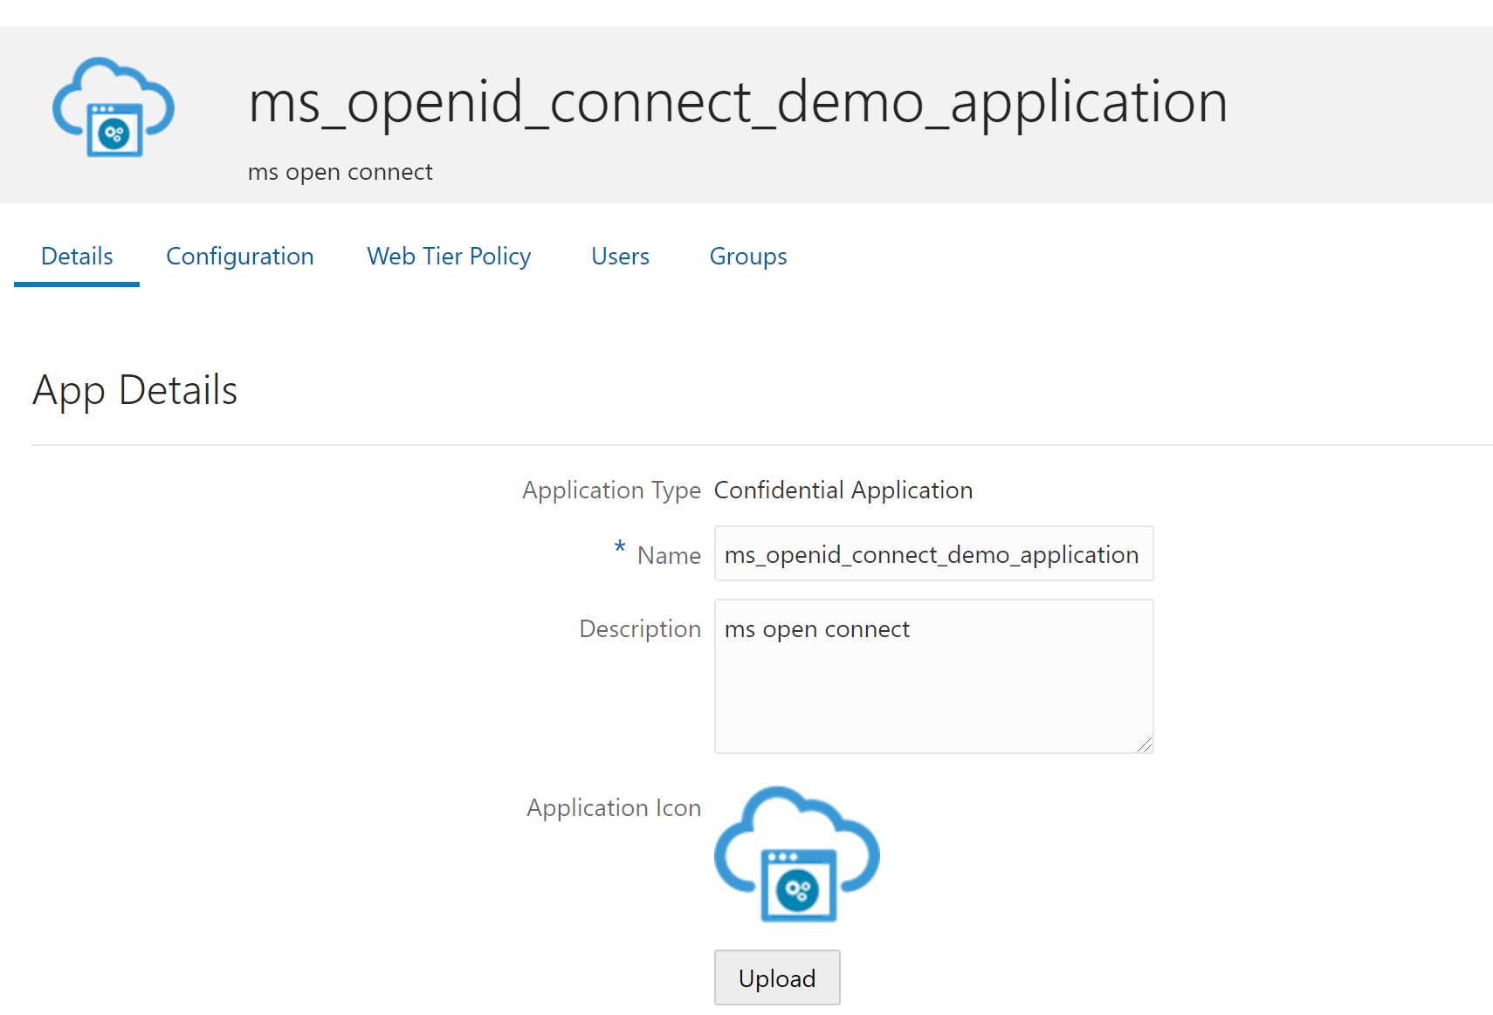
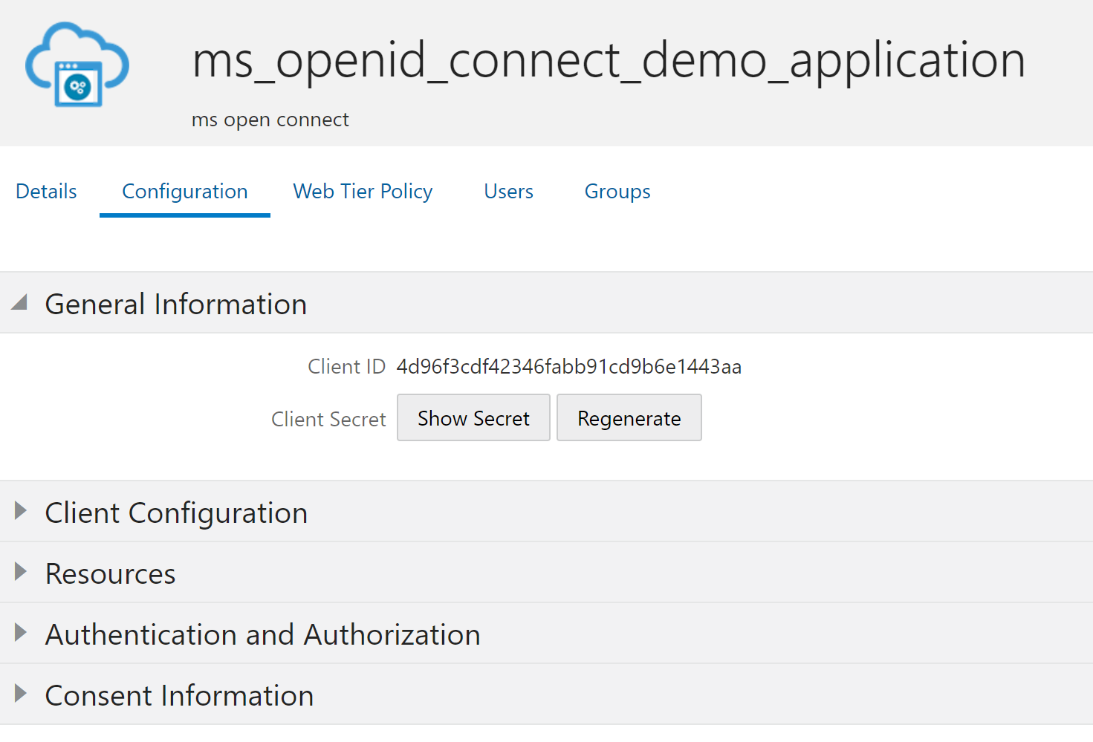
Oracle Setup
Azure B2C with Oracle
Create Application and noted down client id, client secret and base URL with region
Create new application
Configuration and client ids..

Slide 22
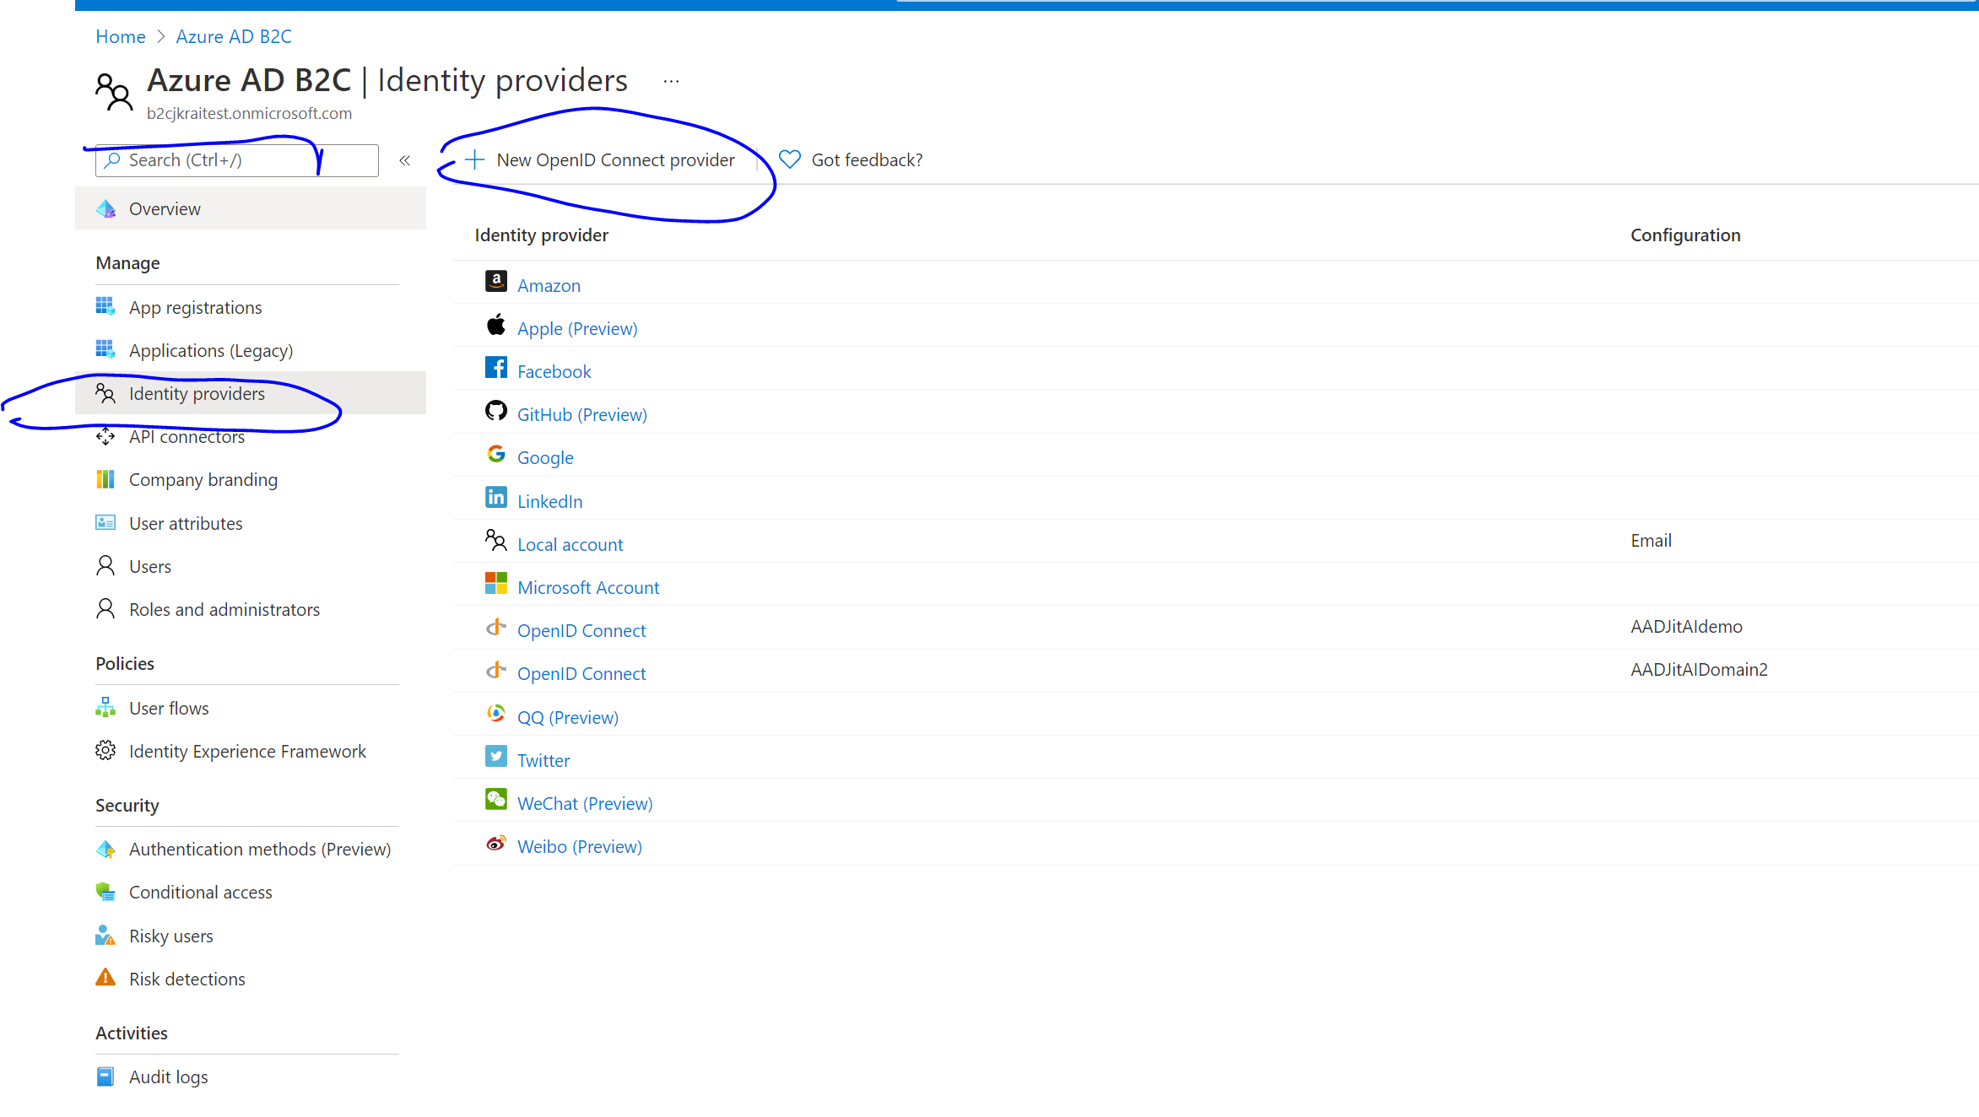
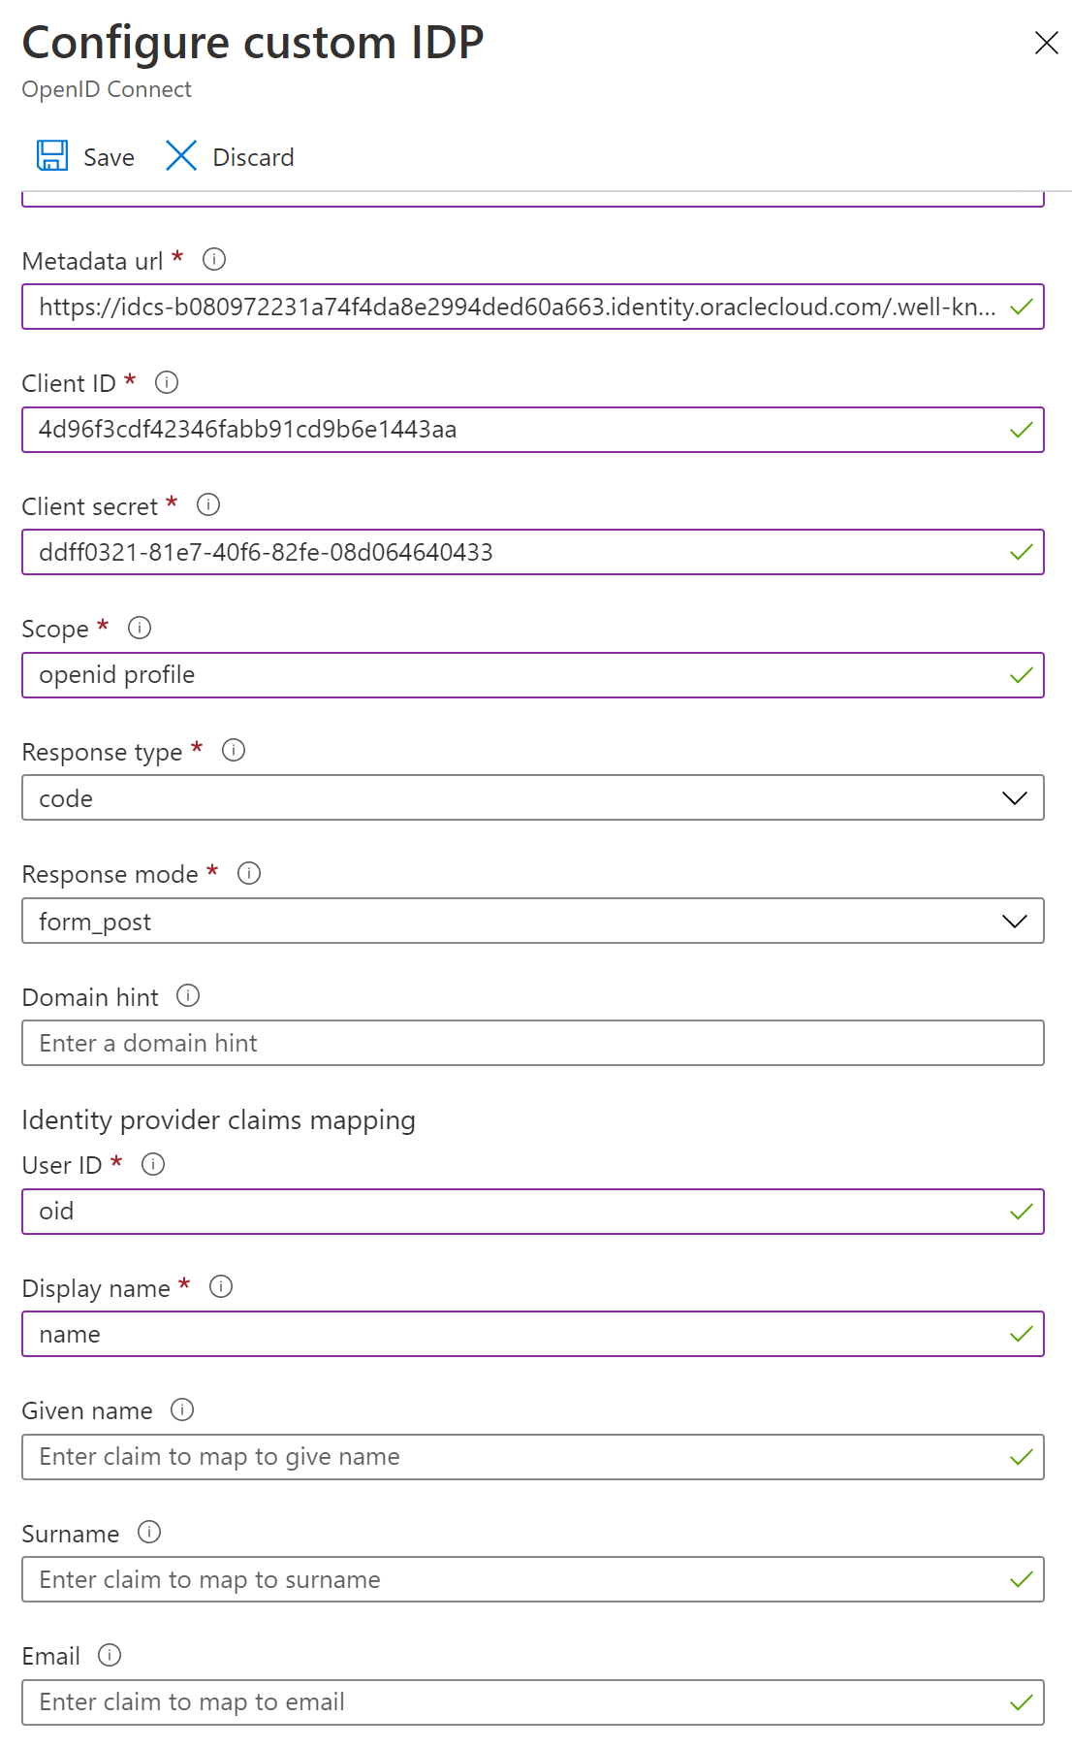
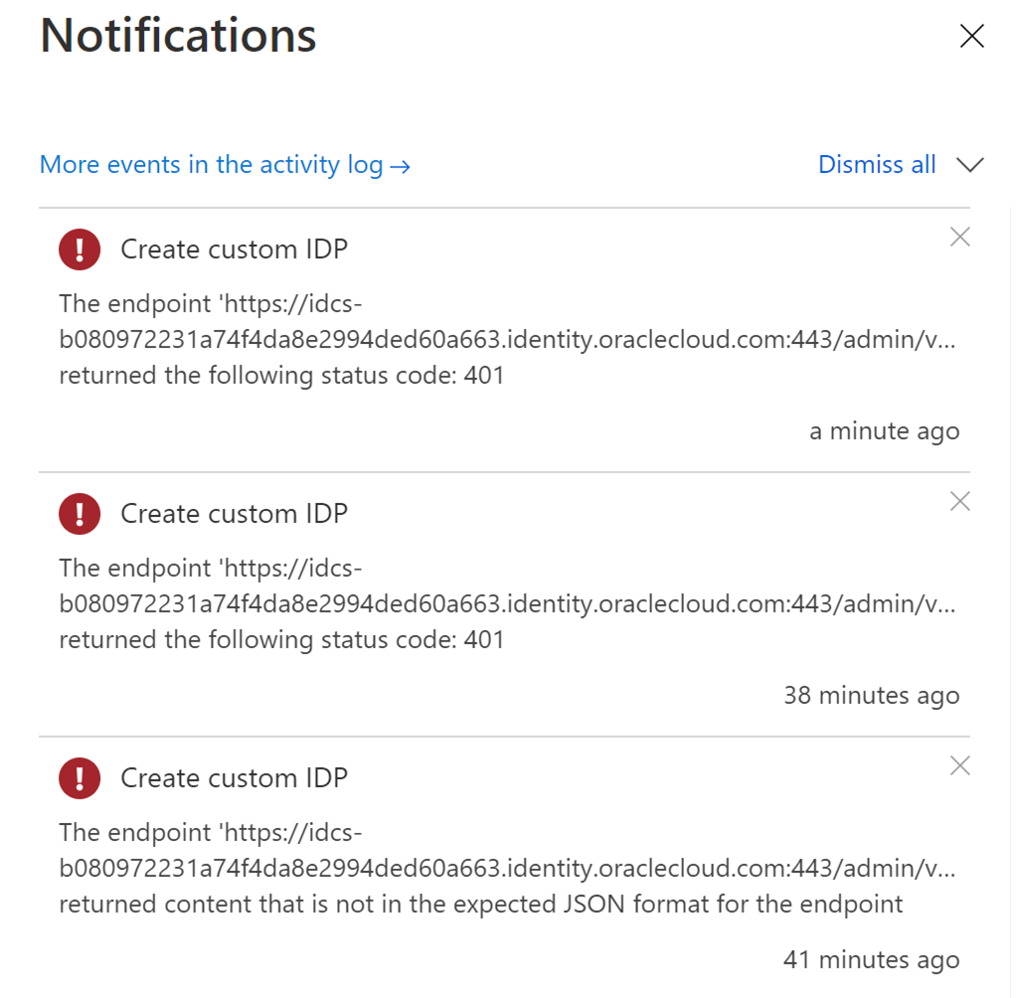
Azure B2C Setup - Azure
Azure B2C with Oracle
1. Login to portal.azure.com
2. Switch to the B2C tenant
3. Open Identity Provider for the B2C tenant
4. Create and configure Open ID connect
Provider.
5. Provide the information as required.
Provide oracle IDCS information

Slide 23
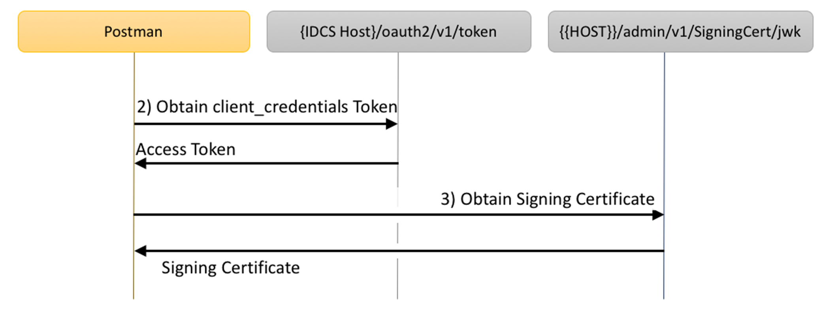
Azure B2C Setup - Azure
Azure B2C with Oracle
-- Using SAML
-- Using Open ID/oAuth 2.0

Slide 24
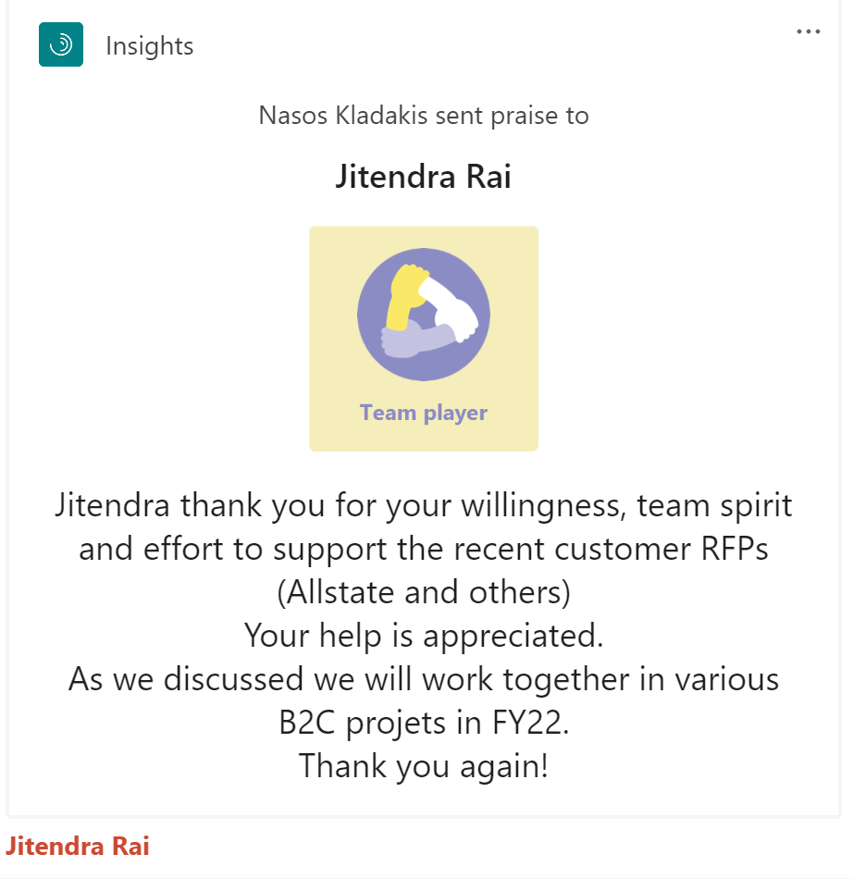
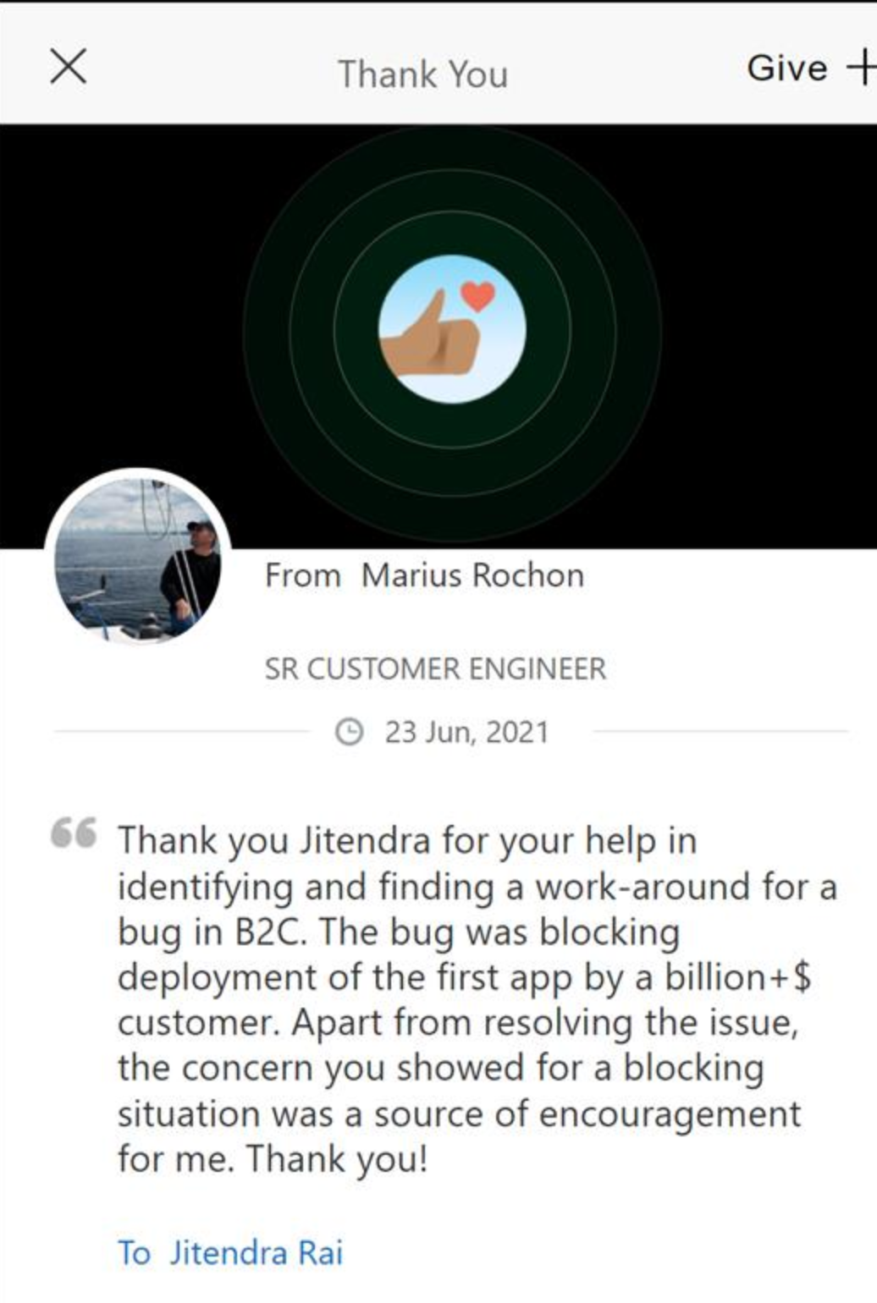
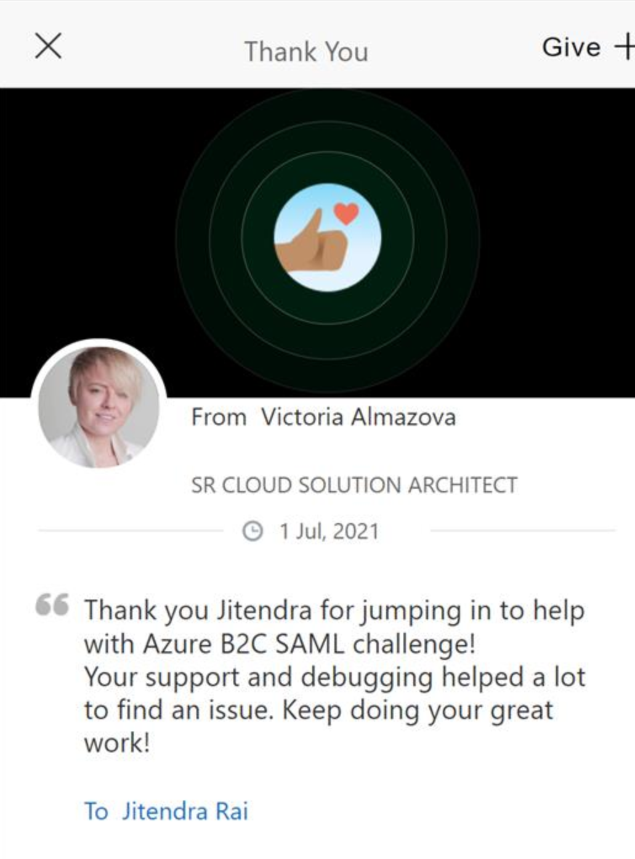
Jit Kudos

Slide 25
Azure B2C Setup
Azure B2C with Oracle
-- Using SAML
-- Using Open ID/oAuth 2.0

Slide 26
Test Steps
Azure B2C with Oracle
-- Using SAML
-- Using Open ID/oAuth 2.0

Slide 27
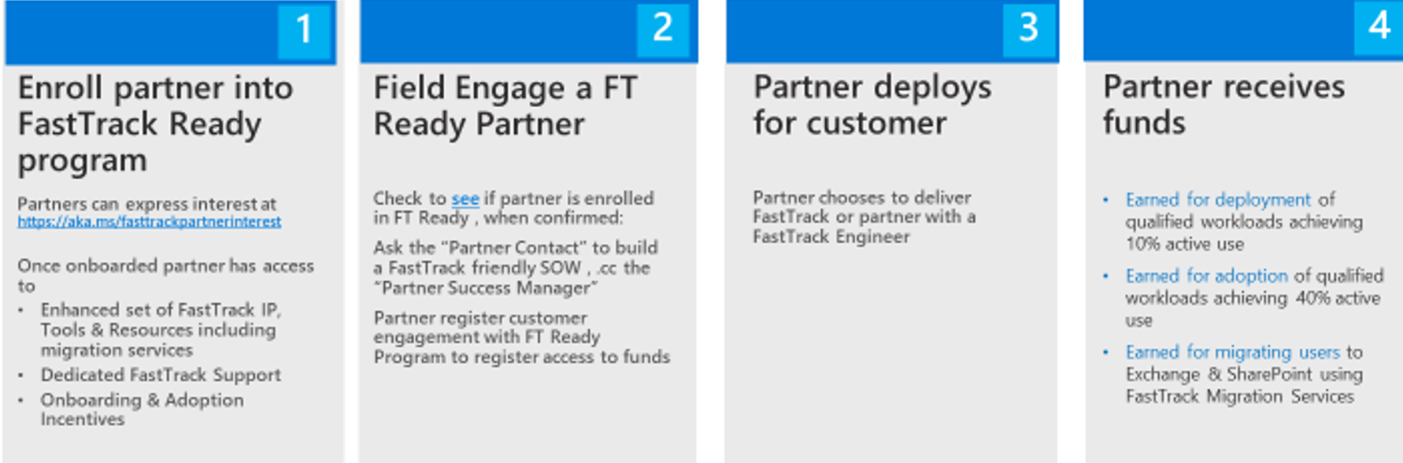
FastTrack Ready Partners
Partner criteria:
Register at least 5 customers
Drive at least 5K active entitlements for a single workload with registered customers
Active Gold competency for a qualified workload: Cloud Productivity (Exchange Online, SP Online, Teams, Skype, Yammer), Cloud Productivity and Windows & Devices (o365 ProPlus), Cloud Productivity and Enterprise Mobility Management.

Slide 28



Q&A

Slide 29

Resources
Training and Solution Guides
Developer course
Identity for Customers and Partners in one app
Migration guidance
GDPR for customer apps
https://aka.ms/aadb2csolutions
Azure B2C documentation
Thriving community
https://aka.ms/aadb2csolutions
azure-ad-b2c
Full demos with source code
Digital Ready talks
https://aka.ms/aadb2cdemo
https://aka.ms/aadb2cdemocode
MW-IIP-DRT307 The Do’s & Don’ts of Deploying Azure AD B2C with the Customer Success Team

Slide 30
Thank you!

